Slide 1
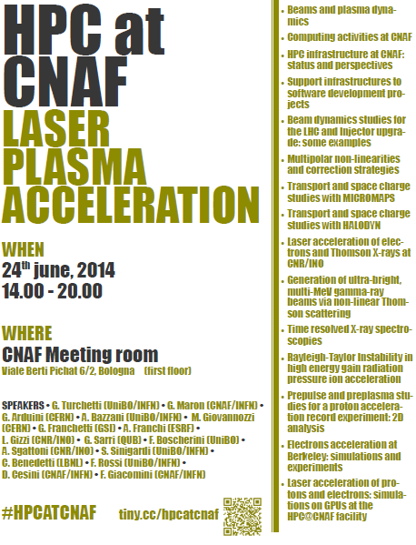

Slide 2
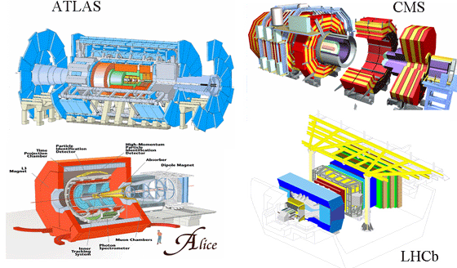
INFN-CNAF
CNAF hosts the Italian Tier1 computing centre for the LHC experiments ATLAS, CMS, ALICE and LHCb....
… but also one of the main Italian processing facilities for several other experiments:
AMS, ARGO, AUGER, FERMI, MAGIC, PAMELA, Icarus, Xenon100, Borexino, Gerda, CTA, Opera, Darkside, Cuore, Virgo
CDF, SuperB, KLOE, LHCf, NA62
Involved in a number of Grid and Cloud national and international projects
WLCG
EGI-Inspire
MCLOUD
Open City Platform
!CHAOS
many other in preparation towards H2020
➔ collaboration with other disciplines

Slide 3
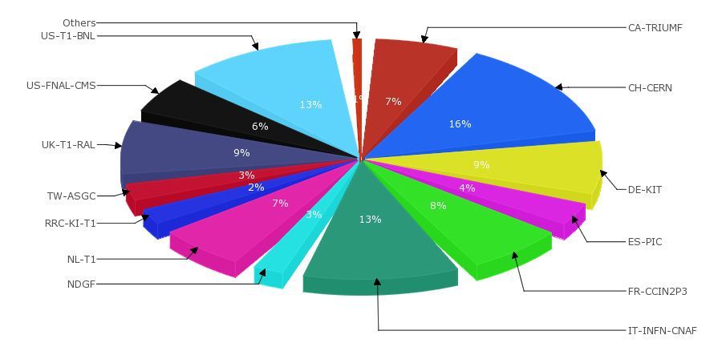
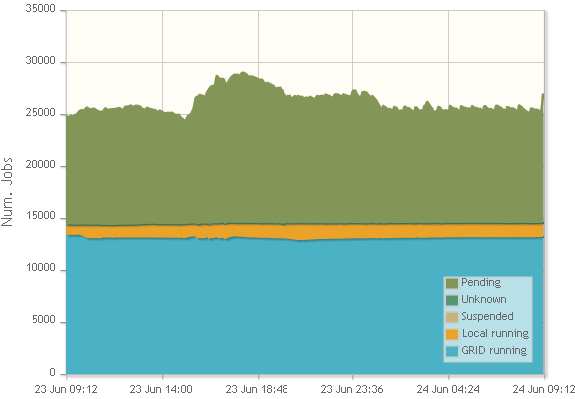
INFN-T1 in Numbers
 | CPU (HS06) | Disk (TB-N) | Tape (TB)
2014 | 150000 | 15000 | 25000
2015 | 205000 | 16000 | 35000
Normalised KSI2k
For the LHC VOs is the second WLCG computing centre, after CERN, in terms of CPU time

Slide 4
HPC at CNAF
In 2014 CNAF started to operate an HPC cluster but remains mainly an High Throughput Center
In the short term is not going to become a supecomputing center
The HPC cluster was created as a collaboration between
Physics Dept. Bologna University
INFN-Bologna
INFN-CNAF
INFN-COKA project
To support local HPC users and their close collaborators
To offer an HPC testbed for developers before moving to other facilities that operates at a greater scale
To acquire expertise at CNAF in a going-parallel world

Slide 5
HPC Cluster at CNAF Status and Perspectives
Daniele Cesini - INFN-CNAF

Slide 6
People and Collaboration
The HPC cluster at CNAF was created thanks to a collaboration between:
Physics Dept. Bologna University
INFN-Bologna
INFN-CNAF
INFN-COKA project
Many operative contributions and support from:
INFN-BO: Vincenzo Vagnoni (ib, storage, gpfs and main screwdriver interventions ☺)
UNIBO: Stefano Sinigardi and Francesco Rossi (gpu, ib, cabling, main testers)
CNAF Farming: Stefano Dal Pra (lsf), Massimo Donatelli (ldap and user account)
CNAF Storage: Vladimir Sapunenko (gpfs)
CNAF Network: Stefano Zani, Lorenzo Chiarelli (switch and uplink)
CNAF Infrastructure: Michele Onofri, Andrea Ferraro (power and cooling)
CNAF R&D: Matteo Manzali (mic)

Slide 7
The Cluster Status
13 Worker Nodes
CPU: 392 + 24 HT cores
320 HT cores E5-2640
48 HT cores X5650
24 HT cores E5-2620
24 HT cores E5-2620
15 GPUs:
8 Tesla K40
5 + 2 Tesla K20
2x(4GRID K1)
2 MICs:
2 x Xeon Phi 5100
2 disks server
60 TB shared disk space
4 TB shared home
1 Infiniband QLOGIC switch 18 ports
1 Eth switch BROCADE 48x1Gb/s + 8x10Gb/s
60 TB
10Gb/s
10Gb/s
Disk server
Disk server
1Gb/s
10Gb/s
1Gb/s
10Gb/s
ETH
2x10Gb/s
1Gb/s
 | CPU | GPU | MIC | TOT
TFLOPS (DP - PEAK) | 3.2 | 19.2 | 2.0 | 24.4
Worker Nodes
IB

Slide 8
Software Stack
LSF9.1 to access the cluster
GPFS for the shared file systems
Compilers
CUDA5.5, CUDA6.0
GCC4.6 (system)
Compiled by us 4.7/4.8 – working on 4.9
icc, ifort
Python 2.7/3.3, ipython
Openmpi-1.5.4
cmake, cmake28, gdb
Others libs
HDF5, FFTW, BLAS, CUBLAS, GSL
Tools
Virtualenv, matplotlib, git, hg, paraview, numpy, scipy, pylab, gnuplot

Slide 9
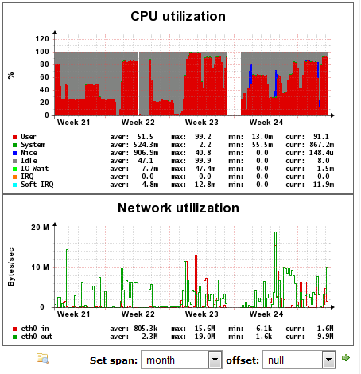
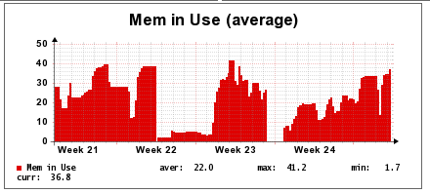
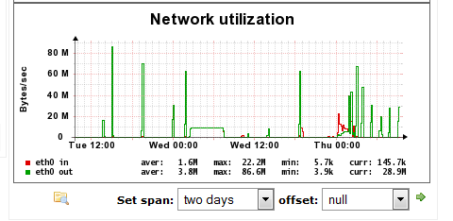
Usage Statistics
LSF
2 batch queues (short, infinite)
1 interactive
Flat configuration
no priorities, no shares
About 1k jobs (last 2 months)
26 registered users
13 active (last month)
(aggregated)
(aggregated)
(aggregated)
90MB/s

Slide 10
Open Issues
Improve availability and storage performance
Fix the redundant disk controller problems (this week, no down)
Upgrade the storage-switch link to 2x10Gb/s
Study the possibility to use infiniband also for storage data
Add monitoring and alarm systems
Accounting for CPU and GPU/MIC usage
Dedicated GPUs queue with reserved cores
Fix the Infiniband problems on 3 nodes
Add a new 24 core 2xTeslaK20 machine
Need the IB adapter
Change the IB adapters of the two X5650 servers (24x2 core)

Slide 11
Cluster Upgrade
The physical infrastructure is not the limiting factor....
...it depends on budget
For further upgrades in the short term:
4 working ports are still available on the Infiniband switch
6x3 new ports can be enabled with just a license upgrade:
3x480 euro+VAT

Slide 12
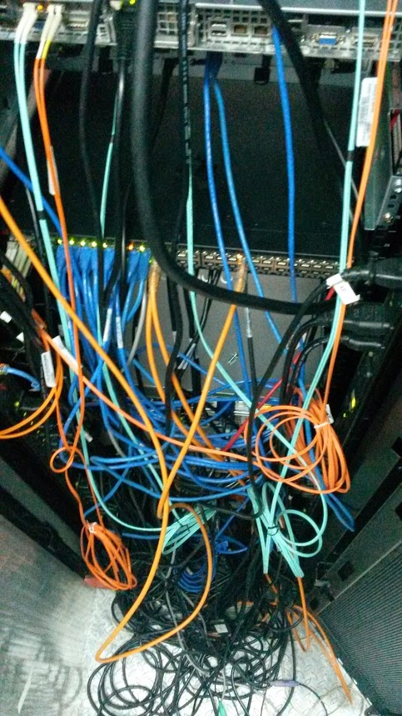
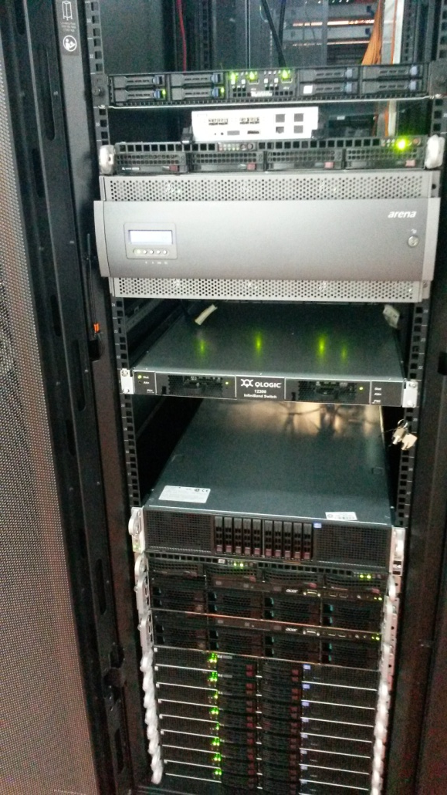
Links and Contacts
http://wiki.infn.it/strutture/cnaf/clusterhpc/home
https://lemon.cr.cnaf.infn.it/lemon-web/info.php?entity=hpc
hpc-support<_at_>lists.cnaf.infn.it
hpc-users<_at_>lists.cnaf.infn.it

