Slide 1
Servizi middleware per il supporto di comunità scientifiche in Italia e all’estero Roberto Barbera (roberto.barbera@ct.infn.it) Univ. of Catania and INFN
Riunione INFN – Bologna, 17 January 2013

Slide 2
Considerazioni iniziali
Per molte comunità, con le quali l’INFN collabora, sia a livello regionale, nazionale che internazionale, le funzionalità computazionali di una infrastruttura grid non sono quelle più importanti
Sempre di più, l’aspetto più rilevante sta diventando quello della «data grid», intesa come una piattaforma per creare e gestire archivi digitali
Un aspetto molto importante,nella gestione dei dati in ambito geograficamente distribuito è quello della loro sicurezza e confidenzialità (es. in medicina)

Slide 3
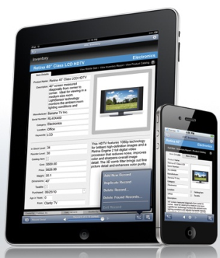
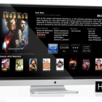
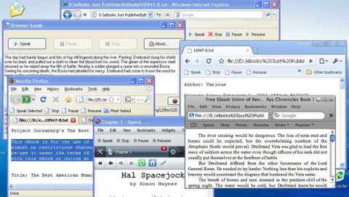
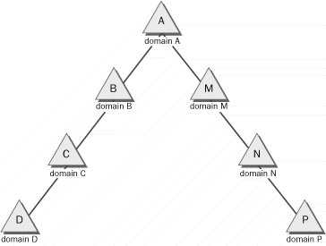
gLibrary Architecture
Science Gateway
gLibrary REST API
Repo 1
Repo 2
Repo 3
Discovery Service
Rest API
Metadata Services
Storage Services
Grid Auth Service
AuthN/AuthZ Services
eToken Service
Databases
Identity Federations

Slide 4
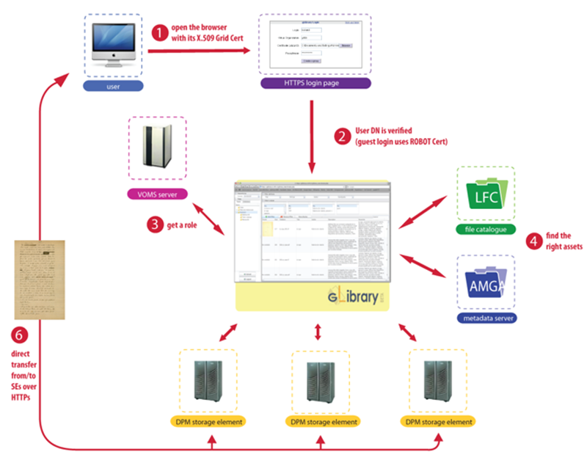
gLibrary interactions

Slide 5
The Secure Storage service
Provides gLite users with suitable and simple tools to store confidential data in storage elements in a transparent and secure way.
The service is composed by the following components:
Command Line Applications: commands integrated in the gLite User Interface to encrypt/upload and decrypt/ download files.
Application Program Interface: allows the developer to write programs able to manage confidential data.
Keystore: a new grid element used to store and retrieve the users’ keys. It is identified by an host X.509 digital certificate and all its Grid transactions are mutually authenticated and encrypted according to GSI model.

Slide 6
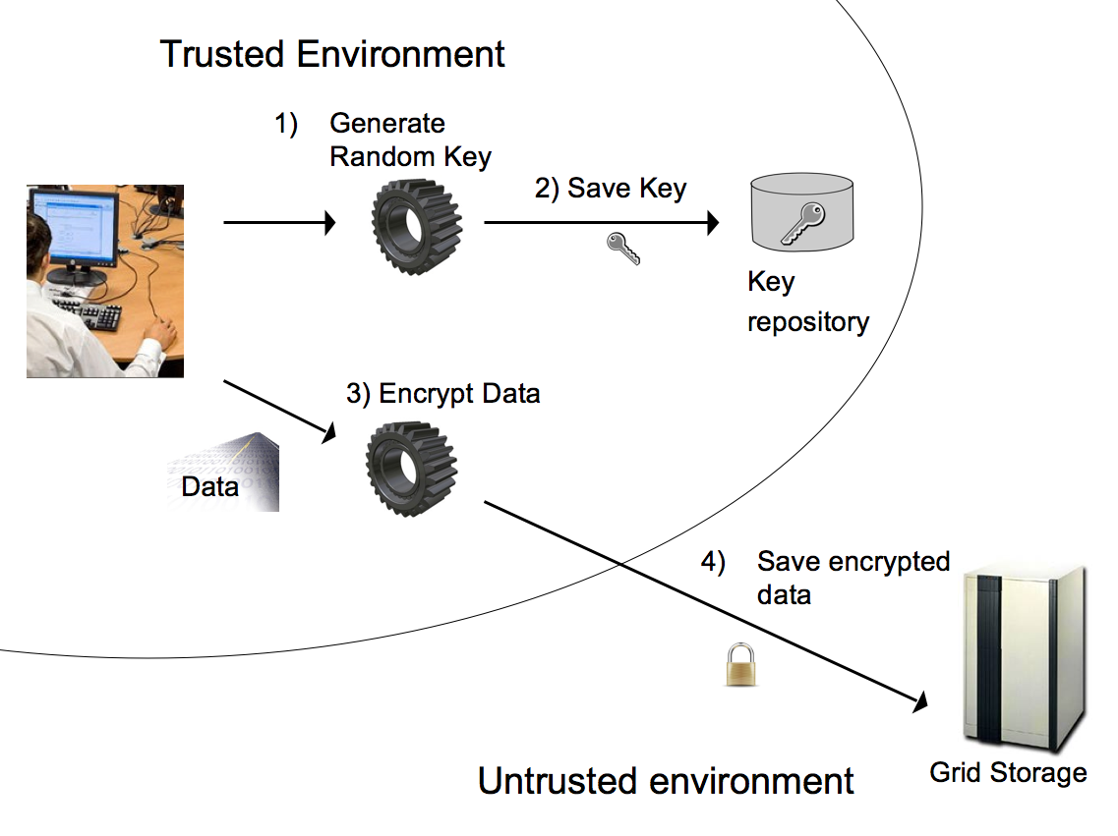
lcg-scr: Encryption and Storage
Access authorized to: DN1, DN2, FQAN1, FQAN2, …
ACL
OWNER DN
DN1
DN2
FQAN1
FQAN2
…
GSI AUTHENTICATED CHANNEL
A FQAN AUTHORIZED TO ACCESS THE FILE CAN REPRESENT A WHOLE VO OR A VO GROUP ETC.

Slide 7
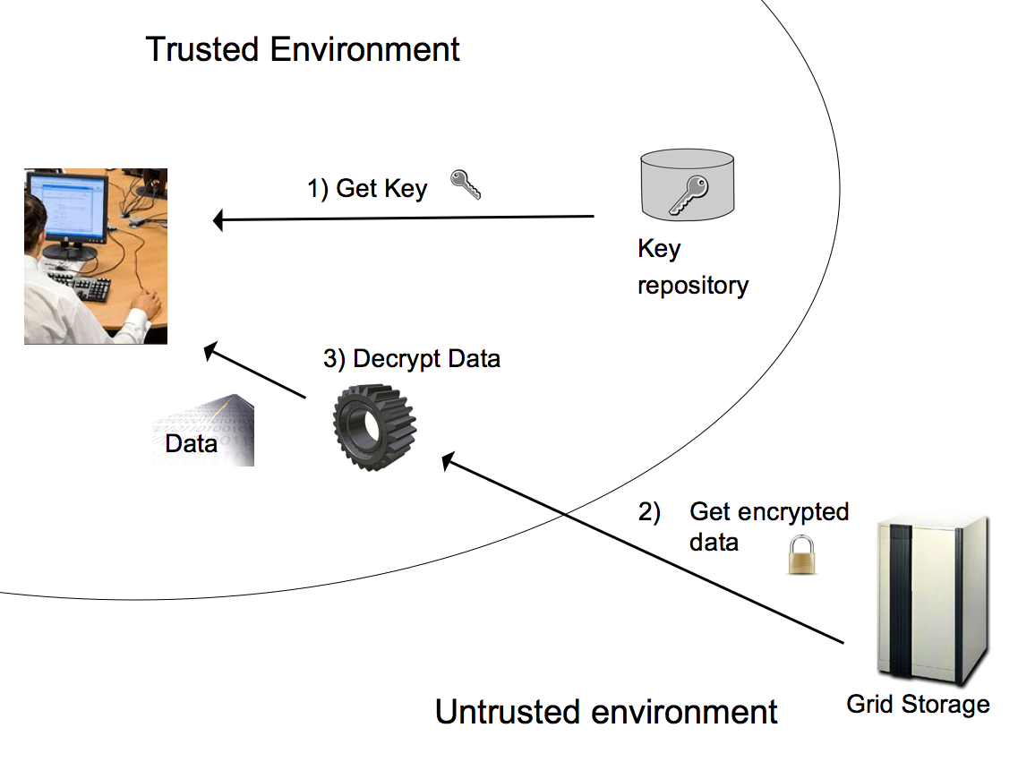
lcg-scp: Retrieval and Decryption
ACL
OWNER DN
DN1
DN2
FQAN1
FQAN2
…
GSI AUTHENTICATED CHANNEL
THE KEYSTORE PROVIDES USERS WITH THE KEY ONLY IF USER’S DN OR ONE OF THE VOMS ATTRIBUTES INCLUDED IN HIS PROXY MATCHES ONE ENTRY OF THE ACL

Slide 8
Secure Storage Service vs. Hydra (as of June 2012)
 | Hydra | Secure Storage Service
gLite 3.2 support | Yes | Yes
file encryption/decryption | Yes | Yes
Data block encryption/decryption (Posix-like API) | No | Yes
Grid Keystore | Yes | Yes
Strong Encryption | No | Yes
Replica management and automatic Key deletion | No | Yes
Shamir’s shared secret scheme support | Yes | No

Slide 9
Considerazioni finali
Necessità di manpower:
Per il supporto a gLibrary: 1 FTE
Per il supporto ad AMGA: 0.25 FTE
Per il supporto a Secure Storage System: 0.25 FTE

Slide 10
Thank you !

