Slide 1
Storage an experiment overview
(with a StoRM perspective …)
Tommaso Boccali – INFN Pisa

Slide 2
Caveats
For RunII (and possibly RunIII) the LHC Experiments’ computing models have been updated “recently”, so we have a guidance
No official document exists for RunIV (Today+10y), so we move into a crystal ball approach
Given the last point, experiments do not seem keen on stating (too) precisely the plans, since
They really do not have a precise landscape
They do not want to commit too early
What you find here for the long term scenario is from private communications, my take on the subject, etc… Don’t blame experiments!
This is even more true for non-LHC experiments, which usually have shorter horizon models; I will focus on LHC Experiments

Slide 3
LHC Schedule & RunX definitions
RunII
RunIII
RunIV
RunV
RunVI

Slide 4
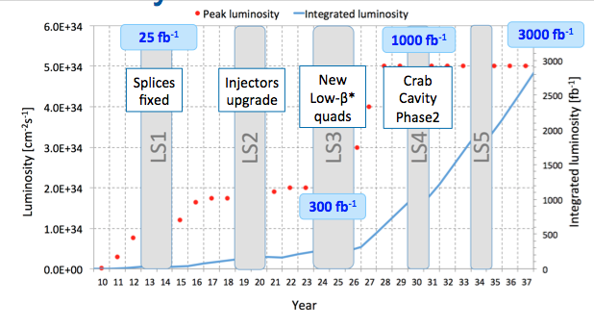
LHC Luminosity profile
Expect by RunVI (pp):
15x Inst lumi wrt 2015
100x Int lumi wrt 2015
today

Slide 5
Run#, terminology (pp, for ATLAS and CMS)
Run2: 2015-2018
Up to 1.5e34, 25 ns, 13 TeV – up to 50 fb⁻¹/y
<PU> = 40
Run3: 2021-2023
Up to 2.5e34, 25 ns, 13 TeV - up to 100 fb⁻¹/y
<PU> = 60
Run4: 2026-2029
Up to ~5e34, 25 ns 13-14 TeV – up to 300 fb⁻¹/y
<PU> = 140 if not 200 (limit comes from leveling, not from LHC)
1 y
6 y
11 y
This is “Phase2” for pp

Slide 6
LHC is not the only source of scaling factors
Resource needs scale also with what Experiments want to collect / process
ATLAS, CMS:
All adiabatic till RunIII included. Resources requested scale with Inst Lumi and mildly with Int Lumi; Trigger rate stable ~ 1kHz
RunIV:
Up to 10 kHz Trigger, up to 7.5e33 cm⁻²s⁻¹: this alone brings a factor ~100x
ALICE, LHCb:
RunIII is the breaking point. Large Trigger rate increases
ALICE up to 50 kHz, LHCb up to 50 kHz
Increase in Lumi (decrease LHC leveling @ point 8): LHCb up to 2xe33 cm⁻²s⁻¹

Slide 7
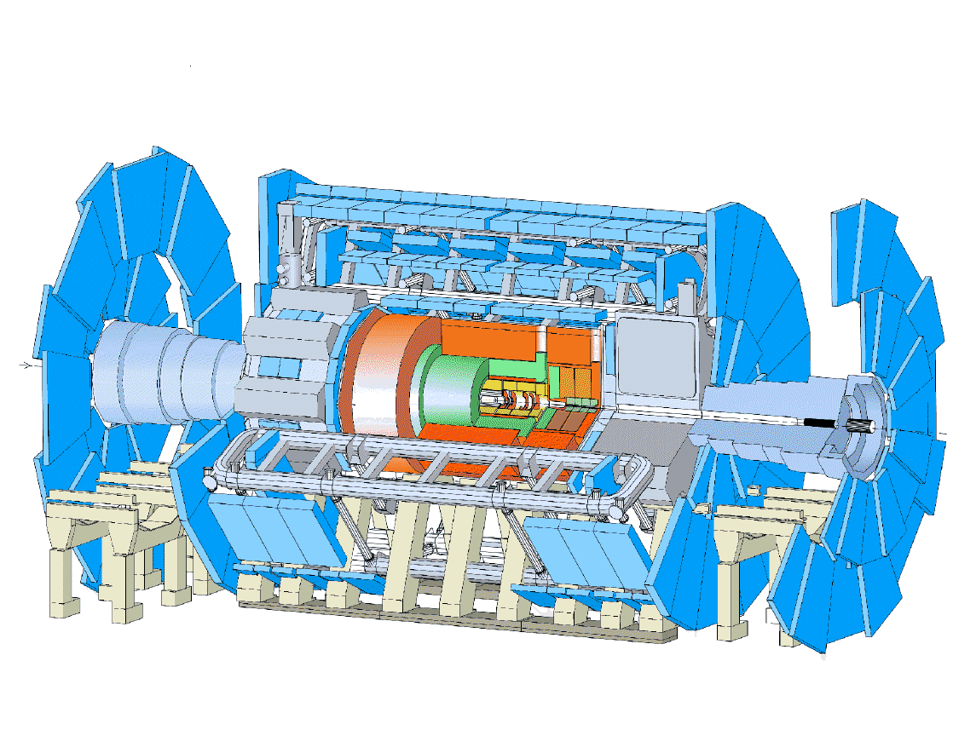
Computing Resource scaling
CPU: scales
Linearly with trigger rate (if you process everything you collect)
More than linearly with <PU>, # tracks, …
Scales with data integrated over some typical window (2-3 years)
Analysis: scales also with # of concurrent analyses
Storage: scales
Linearly with trigger rate
Less than linearly with <PU>, …
Scales with data integrated since the start (at least the tape)
If you plug in rates, event complexity, σ, etc, you end up with
Totals wrt Run1: Run2(3) = ~6-10, Run4 >100
OFFLINE
Various Trigger Levels
Rate
#sec/year
Event Size
<PU>

Slide 8
Resource deployment - 2015
From Rebus/WLCG
T0: 700kHS06, 50 PB Disk, 100PB Tape
T1: 1MHS06, 100 PB Disk, 200 PB Tape
T2: 1.5MHS06, 100 PB Disk
… and scaling, mostly all approved by now

Slide 9
The different experiments have different timing:
ATLAS/CMS: Run4 is the inflation
LHCb/ALICE: Run3
Buncic™
PB
RAW DISK/TAPE
Very rough estimate of a new RAW data per year of running using a simple extrapolation of current data volume scaled by the output rates.
To be added: derived data (ESD, AOD), simulation, user data (which is easily a big factor)

Slide 10
Let’s move to storage needs/use patterns
The initial Computing Models had a clear distinction for protocols for
WAN data movement (in the MONARC hierarchy):
Human driven (later also algorithms)
Throughput oriented protocols, with full fledged security model
Tape aware, Space token aware
SRM as protocol, many implementations
CASTOR, DPM, BeStMan, dCache, StoRM…
LAN oriented protocols, internal to sites
Posix, RFIO, Xrootd, Dcap, ....
More optimed (not all) for random access
Not necessarily implementing a security model apart from the Posix one

Slide 11
RunII Situation – Exec summary
Apart from ALICE (which stands differently from the others for the whole talk), SRM is still the main interface for WAN file transfers
Used for Disk <-> Disk, Disk <-> Tape
Indeed, already in 2011, WLCG TEG recommended (among other things) that SRM is an overkill for any transfer not involving tape
Experiments seem indeed quite open in that direction

Slide 12
SRM servers used as of today @ T1s
CERN: CASTOR + EOS
ASGC: CASTOR
BNL: dCache
CNAF: StoRM
FNAL: dCache + EOS
IN2P3: dCache
JINR: dCache
KISTI: DPM
KIT: dCache
NDGF: dCache
NL-T1: dCache + DPM
PIC: dCache
RAL: CASTOR
RRC-KI-T1: dCache
TRIUMF: dCache
T2s+T3s: mostly dCache and DPM, some with StoRM (30 as far as I was told…)

Slide 13
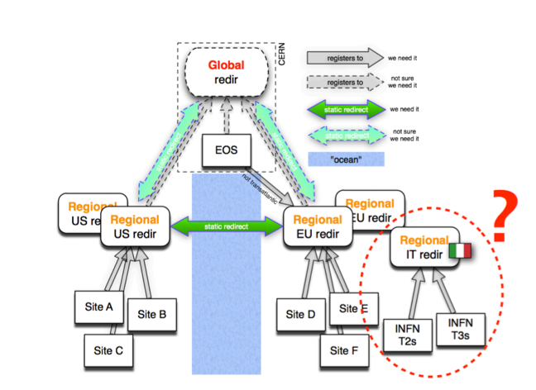
New (more or less expected) perspectives for the future - Expected
Remote access protocols:
XrootD
Historically the main protocol for ALICE for … everything
Initially planned by the rest of the LHC Experiments as fallback, i.e. in order to strengthen the infrastructure
RunII: expected ramping of remote reads on purpose
CMS: up to 20% of the access from jobs as remote; ATLAS: up to 20% of the WAN bandwidth
Either user driven (BAD: send jobs uncorrelated with data location), or System Driven (Overflow by the WM, which takes into account limits, “network vicinity”, etc)
In general, access structured in Federations, which try and insure the best network path (w/o a global location DB, in order to allow sites to pop in/out dynamically)
WebDAV/Http
Reaching same functionality levels, a bit behind as Experiment Support
ATLAS better than CMS, currently;

Slide 14
Less expected (at least as scale)
Due to budget problems (and, realistically, to the huge increase of requests), opportunistic computing / commercial procurements are becoming an essential part of the Exps’ computing models – See ATLAS
While it is “easy” to buy/find Computing resources, it is less true for Storage
This drives into some different directions
(Dynamic) Data Caches
(Again) remote access
In case of local storage, be ready to accept whatever is offered
S3 is an example
These directions are barely touching a standard “owned” Tier Site
Other site-related dynamics:
Example is RAL willing to go Ceph/S3 entirely, w/o SRM support at ALL

Slide 15
On the same page ($$$)
All the experiments would LOVE limiting the tape usage (and thus the SRM interactions) to the bare minimum
Permanent Storage of RAW data
Temporary (but ~ long term) storage of reference samples
In the presence of sizeable Disk resources, the Tape would be ~ never read back
A very few times, like for a global reprocessing at a end of a Run – not a year!
Reality is that in periods of budget problems tape storage (~5x cheaper than disk) is going to be used also as a fast turn-around low-quality disk area, which increases a lot
Number of recalls per file
Deletions, repacking, bandwidth needs, stress on readers
(SRM utilization more on the critical path)

Slide 16
More complex patterns?
In most of our sites (HDFS ones being the exception), a separation Storage / CPU is present
This has proven optimal from the Sites’ operational point of view, is that ok for the future?
Machine Learning and Big Data are the new buzzwords for efficient large scale data analysis, and they come with a price:
Hardware and Software are more entangled in order to maximize performance
Tools like Spark, Pig, Hive require a different hardware setup, and Experiments can request on the longer run to have specific centers – if the standard architectures are not able to fulfill

Slide 17
Authorization / Authentication
Which is the future of these aspects?
X509 is ok for standard (GRID) use, but what if we start writing / reading via SRM from Clouds / Opportunistic / portals?
There preferred AAIs are SAML, ID-Federations, and such. We need a bridging, and indeed there are some efforts around this.
Does this have direct impact on SRM/StoRM?
Are you relying on external bridging services?
Are you planning to have these protocols internally supported?

Slide 18
Feature explosion
For example:
Right now StoRM supports also WebDAV
To my understanding, preferred over WebDAV on GPFS/Posix just for ACLs
On the other hand, Xrootd supports WebDAV
I understand it better, since in this case Xrootd also serves as disk merging tool
General message I gathered from the experiments: in case of support issues of StoRM, better focus on the core functionalities (SRM)
If we can vote, new functionalities are much lower priorities than maintaining the tape functionalities, which are unique and essential to SRM

Slide 19
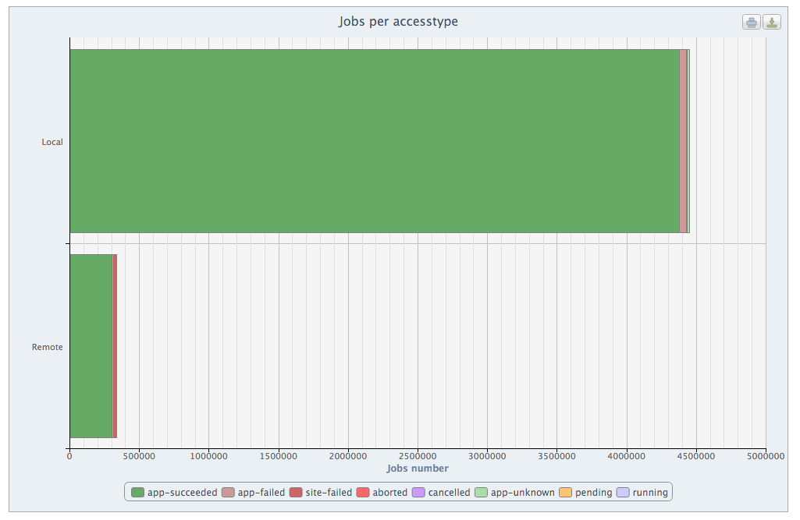
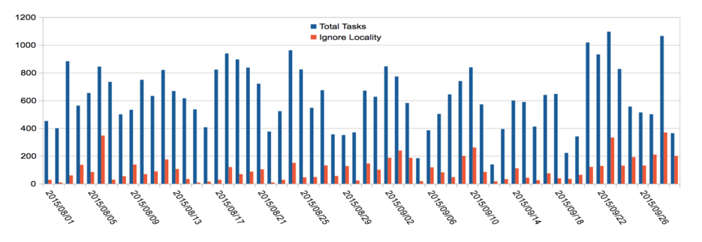
This is all real, not plans …
CMS traffic on WAN is 80% SRM, 20% XrootD
(still, this is much BELOW (10x) the LAN traffic)
Remote access jobs exist and are at least O(10%)

Slide 20
What are we using today SRM for?
CMS, ATLAS:
Most of the remote transfers (notable exceptions are XrootD and GridFTP)
Totality of Tape Interactions
essential for PrepareToGet/PrepareToPut
LHCb:
a larger share of Xrootd for remote Disk to Disk transfers
SRM used as a monitoring tool (space monitoring)
ALICE:
No SRM at all (Xrootd with site specific stagein/out mechanisms – GEMSS here)

Slide 21
Medium/Long term statements
Medium Term (up to RunII at least, probably up to RunIII):
No big changes of utilization pattern
Steadily increase of streaming accesses, also due to better quality overflow site matching
Increase in the number of file access / transfer protocols, if they allow for a more widespread access to resources.
Disk to Disk transfers not really needing SRM, can be ok with GridFTP, Xrootd, Httpd
SRM remains the tool when tape is involved
Storm needed at least up to the end of RunIII (2023?)

Slide 22
Long(er) term
Much more difficult to predict …
One can imagine random access enabled protocols (Xrootd, Httpd, whatever will rise as a standard…) being more widely used also for organized data transfers
Cloud-like storage will start to be much more present, with protocols like S3 and object storage systems a-la Ceph
Unavoidable if we start buying storage from providers
But still, this does not exclude the possibility to have SRM as small layer over cloud FSs – StoRM is exactly this
Difficult to state SRM/StoRM will be a total necessity, but still some mean of interaction with tape will be necessary.
RAL/Ceph is a nice experiment, let’s see if they are really able to satisfy experiments’ needs.

Slide 23
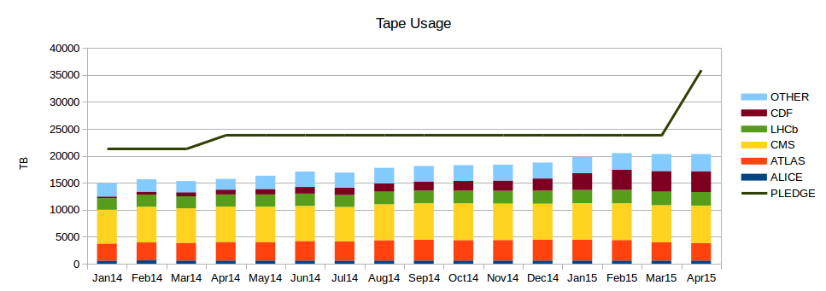
(non-LHC Experiments) – fast check with the usual suspects
BelleII
No tape usage until 2020 (@ CNAF)
Later, they need Buffer->Tape operations and (more critical?) bulk stageout before reprocessing
Can be served in other ways (like ALICE now), otherwise seems a clear use case for SRM
Keen to adapt any existing solution, not really willing to implement new ones
Other Exps (mostly Astroparticle) - totalling few PBs all together
Mostly WriteOnce/ReadNever (custodial copy)
Write on Buffer, recall on demand (using GEMSS) mostly fine
For the few cases where bulk recalls are needed, support personnel act by hand
If they are asked, they would vote for “anything, but with a Posix interface and a single (virtual) FS”
TAPE USAGE (2014-2015) – ALL VOs
TB
“The rest”

Slide 24
Conclusions(?)
At least up to the point we can see now, SRM seems still on the critical path for Experiments
Mostly (if not only) for tape interactions
Much less for Disk to Disk transfers
Used, but there are not negligible exceptions – and, mostly, Experiments would know how to switch even today if needed.
Some Experiments (LHCb notably) use SRM also as a monitoring/querying tool
Total space used , …
Considering RunII as a trivial (!) extension to run II for pp, this would suggest the need for StoRM up to ~2022

