Slide 1
EGI-Inspire: stato delle attivita', dei risultati ottenuti e delle esigenze per il 2013
P. Veronesi

Slide 2
agenda
Il progetto EGI-InSpire
Raccomandazioni TEG sulla sostenibilita’ delle Operations
Necessita’ comuni in ambito INFRA (?)
Automazione delle Operations
Attivita’ EGI-InSpire -Networking Activities (NA.*)
Slide di Luciano
Attivita’ EGI-InSpire -Joint Research Activities (JRA1.*)
Accounting nuovi tipi di risorse, compreso Cloud
Sviluppo tool di Operations
Attivita’ EGI-InSpire - Operations (SA1.*)
Attivita’ EGI-InSpire - Provisioning the Software Infrastructure (SA2.*)
Coordinamento staged rollout;
Release UMD
Supporto specialisticio migrato in SA1
Attivita’ EGI-InSpire - Services for the Heavy User Communities (SA3.*)

Slide 3
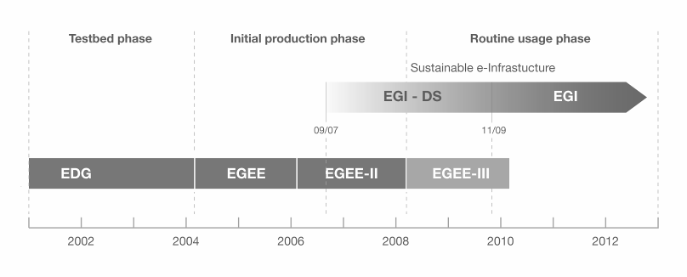
Le e-Infrastrutture a livello europeo
Credits: https://agenda.infn.it/materialDisplay.py?contribId=16&materialId=slides&confId=5455
European Data Grid (EDG)
Primo sviluppo middleware e realizzazione di testbed
Enabling Grid for E-sciencE (EGEE) I-II-III
Dal prototipo all’infrastruttura di produzione
European Grid Infrastructure (EGI)
L’infrastruttura Grid verso la sostenibilità → ruolo chiave delle National Grid Initiative (NGI)

Slide 4
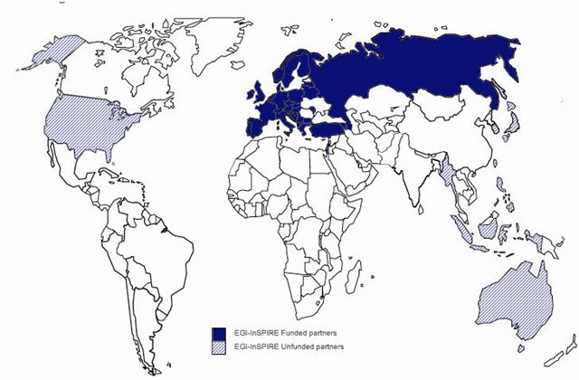
The EGI-InSPIRE Project
Credits: https://agenda.infn.it/materialDisplay.py?contribId=16&materialId=slides&confId=5455
Integrated Sustainable Pan-European Infrastructure for Researchers in Europe
A 4 year project with €25M EC contribution
Project cost €69M
Total Effort ~€330M
Staff ~ 170FTE
Funded
Un-Funded
Project Partners (48)
EGI.eu, 37 NGIs, 2 EIROs, 8 AP

Slide 5
Operations Sustainability Dalle raccomandazioni del TEG Ops
Reduce operations effort
Service Coordination and Commissioning, Site and Network Monitoring, Software deployment, Middleware Services
Reduce complexity
Software deployment, Middleware Services and Deployment
Minimize inter-dependencies (sites, experiments, services)
Software deployment, Information System
Reduce effort to upgrade and reconfiguration
Middleware deployment
Improve access to information
Information System, Availability, Site and Network monitoring
Improve reaction to service/hardware failures
Site Monitoring
Deploy scalable services (2-3 times above the average load)
Middleware Services
Focus su attivita’ sistemistica, manca il supporto agli utenti/comunita’

Slide 6
Necessita’ comuni in ambito INFRA (?)
Collezione requirement per lo sviluppo
Middleware
Repository, staged rollout, Release (?)
Monitoring, allarmistica, accounting
Nagios, GOCDB, dashboard, reportistica, accounting, HLRMon, WMSMon
Supporto
Site manager, comunita’, utenti, sistema di ticketing
Servizi Core
GRID: Top-bdii, WMS, Cataloghi, distribuzione software di esperimento (cvmfs), portale/i, CA Online, IDP
Security
Monitoring, gestione incidenti, best practice
CLOUD
Data Center Automation?

Slide 7
Clouds@EGI
Credits: https://agenda.infn.it/materialDisplay.py?contribId=16&materialId=slides&confId=5455
Attività iniziate in una Task Force (partecipazione su base volontaria e in best effort)
Creato recentemente un nuovo Task:
TSA2.6: Federating Private Clouds
confluisce il lavoro della TF
effort finanziato dal progetto
Varie soluzioni cloud, interoperanti via OCCI
INFN/IGI partecipa con WNoDeS
in ambito INFN ci sono esperienze di Cloud (IaaS) con openstack e opennebula.

Slide 8
Data center automation
In ambito Operations abbiamo acquisito esperienza sulla gestione automatizzata di data center.
Prodotti OpenSource: The Foreman, Mcollective, Puppet
L’adozione di procedure e strumenti comuni in questo ambito puo’ incidere molto sulla sostenibilita’ delle operations.
Il CERN sta portando avanti un progetto analogo con gli stessi tool per la gestione del data center del CERN e di quello Ungherese, sia per la parte Grid che per la parte Cloud (openstack)
Pochi e grandi datacenter automatizzati vs tanti e piccoli, gestiti manualmente

Slide 9
Macro Attivita’ EGI-InSpire
BACKUP

Slide 10
NA - Networking Activities
Overall Strategy
The networking activities presented in the following sections are designed to:
Ensure the management of the project and the administration of the consortium.
Coordinate the development of policies for a sustainable European e-Infrastructure both, internally within EGI and externally, with collaborating projects and initiatives.
Liaise with EGI‘s user communities, including both, those organized within VRCs and those without, to collect feedback on the EGI services and the community‘s future infrastructure requirements.
Per le attivita’ in ambito user communities, vedere slide su IGI

Slide 11
JRA1 - Joint Research Activities
Objectives
This activity provides for the continual evolution of the operational tools used by the production infrastructure, including:
The ongoing maintenance and further development of the deployed operational tools
The development of the operational tools to support a national deployment model (tool regionalisation)
Accounting for the use of different resources within the production infrastructure
Providing an integrated operations portal for the staff running the production infrastructure
TJRA1.2 Maintenance and development of the deployed operational tools
TJRA1.3 Supporting National Deployment models
TJRA1.4 Accounting for usage of different resource types
TJRA1.5 Integrated Operations Portal

Slide 12
Provisioning the Software Infrastructure (SA2.*)
Objectives
This activity will coordinate the external provision of software required by EGI to form the production infrastructure. It will:
Establish agreements with key software providers
Maintain the UMD Roadmap
Define general and component specific quality criteria to be applied to software components
Verify the software components against these criteria
Provide a repository for the software components within UMD and the related support tools

Slide 13
Services for the Heavy User Communities - SA3.*
Objectives
This activity provides continued support for activities currently supported by EGEE while they transition to a sustainable support model within their own community or within the production infrastructure by:
Supporting the tools, services and capabilities required by different heavy user communities (HUCs)
Identifying the tools, services and capabilities currently used by the HUCs that can benefit all user communities and to promote their adoption
Migrating the tools, services and capabilities that could benefit all user communities into a sustainable support model as part of the core EGI infrastructure
Establishing e a sustainable support model for the tools, services and capabilities that will remain relevant to single HUCs
The work in SA3 has many benefits to other HUCs (e.g. EIRO and ESFRI) and more broadly the general DCI community.

Slide 14
Servizi EGI/IGI - Operations
TSA1.1 Coordinamento Europeo – Internazionale
TSA1.2 Security
TSA1.3 Staged Rollout, Interoperability
TSA1.4 Operational tools
GOCDB, Monitoring e Allarmistica
TSA1.5 Accounting
TSA1.6 Regional Helpdesk
TSA1.7 Supporto Comunita’ e site manager
TSA1.8 Gestione servizi Grid CORE (e Cloud?);
WMS, VOMS, TOP-BDII, LFC, MyProxy, Portale (IDP, CA ONLINE), Cloud (Wnodes, e IaaS) , CVMFS
Cloud (IaaS)

Slide 15
TSA1.1N Activity Management
participation to the Operations Management Board (OMB)
participation to bi-weekly operations meetings
Review of SA1 and non-SA1 milestones and deliverables
17/01/2013
EGI-Inspire: stato delle attivita', dei risultati ottenuti e delle esigenze per il 2013
15

Slide 16
TSA1.2N A Secure Infrastructure - NGI
participation to EGI CSIRT. EGI CSIRT covers all aspects of operational security aimed at achieving a secure infrastructure within EGI. It ensures both the coordination with peer grids and with the NGIs and NREN CSIRTs.
Incident Response Task Force (IRTF) Handle day to day operational security issues, coordinates Computer-Security-Incident-Response
Security Drills Group (SDG) testing of the inter CSIRT communication channels and assessing the Site-Security-Teams readiness to handle IT-security incidents.
Security Monitoring Group (SMG) Develop, deploy and maintain security monitoring tools.
Training and Dissemination Group (TDG) Raise security awareness and improve security for system administrators by providing security training and best practice
participation to the EGI Software Vulnerability Group (SVG). The purpose of the EGI Software Vulnerability Group is to eliminate existing vulnerabilities from the deployed infrastructure, primarily from the grid middleware, prevent the introduction of new ones and prevent security incidents.
17/01/2013
EGI-Inspire: stato delle attivita', dei risultati ottenuti e delle esigenze per il 2013
16

Slide 17
TSA1.2N A Secure Infrastructure - EGI
EGI Global task
Coordination of EUGridPMA
Coordination of operational security

Slide 18
TSA1.3N Service Deployment
Participation to staged rollout of middleware component updates
Interoperability at the NGI level: operation of multiple middleware stacks and novel resources (virtualization, HPC, etc.), interoperability with regional grids, feeding interoperability requirements into EGI
EGI global task
Definition and implementation of a new workflow to automate software deployment cycle, from release of the sw developers to deployment
Coordination of the staged rollout activities carried out by the NGIs
Liaison with gLite Collaboration release team (interim)
Chairing the operations meetings
Operational interoperation between NGIs and with international Grids, e.g. of the accounting and monitoring infrastructure, gathering or requirements

Slide 19
TSA1.4N Infrastructure for Grid
Deployment (system management and validation) of regional instance of operational tools:
regional Nagios and MyEGI portal (mandatory)
regional GOCDB (prototype available)
regional operations portal and dashboard
regional accounting portal (prototype available)
Provide feedback on tool deployment issues and requirements
EGI global task
Deployment of central operational tools
GOCDB (STFC),
operations portal and dashboard (IN2P3),
central Nagios-based SAM components and MyEGI (CERN),
central messaging infrastructure (AUTH),
central network monitoring tools (downcollector) (GARR)
Migration plan to EGI.eu domain, failover configurations
Coordination of regional deployment of tools (e.g. Nagios)

Slide 20
TSA1.5N Accounting
Deployment (system management and validation) of regional instance of accounting infrastructure:
Regional accounting portal
Regional accounting repository
Check for correctness and completeness of accounting information
Chaise sites not publishing accounting records
Provide feedback on accounting requirements
EGI Global task
Central accounting repository - (STFC)
Central accounting portal - (CESGA)
Gathering new accounting requirements

Slide 21
TSA1.6N Helpdesk Infrastructure - NGI
Regional helpdesk
Deployment of regional helpdesk interworking with GGUS
set up a regional ticketing system, make use of a xGUS regional, instance or use GGUS directly
ensure the stable operation of the regional ticketing system, if applicable
get in contact with GGUS staff support at ggus.org to clarify the specification of the interface with GGUS or your xGUS customisation
register your NGI as a new SU at the GGUS Savannah or open a GGUS ticket for this
provide an FAQ based on a template provided by GGS which describes your NGI support infrastructure, a contact email address
Provide feedback about helpdesk requirements in the framework of the USAG group

Slide 22
TSA1.6N Helpdesk Infrastructure - EGI
EGI Global task
Deployment of central EGI helpdesk (GGUS):
System management of the tool and deployment of new releases
Implementation of failover configurations
Maintenance of GGUS Support Units
Validation of GGUS ticket reports

Slide 23
TSA1.7 (N+E) Support Teams
NGI
Regional support
1st and 2nd line support to national users and NGI sites
Grid oversight of an NGI (aka ROD)
NGI network support
Communities Support (non WLCG)
EGI Global task
Central support
Grid oversight (COD) – Netherlands, Poland following up of escalated operational issues
Site suspension
Follow up of sites failing to provide 70%/75% monthly availability/reliability
Ticket Processing Management (TPM) – first line support, coord: H. Dres (KIT), A. Paolini (INFN)
Coordination of network support - M. Reale (GARR)
Software support

Slide 24
TSA1.8N Providing a Reliable Grid - NGI
NGI:
Deployment of NGI core middleware services (top-BDII, FTS, WMS/LB, central LFC, VOMS)
Operation of national CA
Follow up of availability issues in the country
Contribute to the maintenance and development of documentation, procedures and best practices
Site certification

Slide 25
TSA1.8N Providing a Reliable Grid - EGI Global Task
EGI Global Task - Catch-all Services
Deployment of central grid middleware services (aka catch-all) - (AUTH)
Dteam VOMS (AUTH)
VOMS service for VOs requesting it (AUTH)
Central Nagios infrastructure for security monitoring
Catch all CA
Validation and distribution of monthly availability/reliability statistics
Enhancement/extensions of Operational Level Agreements
Maintenance and development (coordination of) operational documentation, procedures, best practices (EGI.eu)

