Slide 1
Rayleigh-Taylor Instability in high energy gain Radiation Pressure ion acceleration
Andrea Sgattoni ^{a,b}
S. Sinigardi^{c,d} , L. Fedeli^{e,b}, F. Pegoraro ^{e,b}, A. Macchi ^{b,e}
ª Politecnico di Milano Italy ^{b} Istituto Nazionale di Ottica CNR Pisa Italy ^{c} Dipartimento di Fisica e Astronomia, Università di Bologna Italy ^{d} INFN sezione di Bologna, Italy ^{e} Dipartimento di Fisica, Università di Pisa Italy

Slide 2
Light Sail & Rayleigh Taylor Instability
New lasers
New targets
Multi-Petawatt pulses and ultrathin targets
Radiation Pressure Acceleration (RPA) feasible
Open questions
energy gain in 2-3D
effects of focalization
number of acc. ions
rise of instabilities
HPC Projects
Particle In Cell simulations (ALaDyn & PICCANTE)
PRACE 10M cpu-hours FERMI (BlueGene/Q @CINECA)
Analytical analysis
Growth rate for Radiation Pressure driven Rayleigh Taylor
instability for thin foil
3D RT instability
Effective acceleration despite quick rise of Rayleigh Taylor Instability
Notes:
Evolution of laser technology and target manufacture for new regimes for ion acceleration

Slide 3
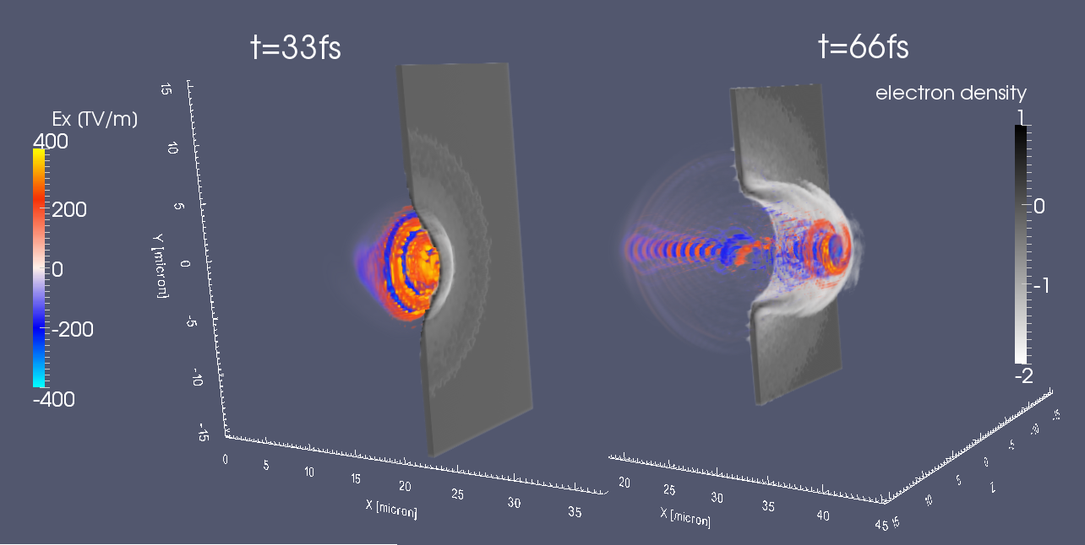
Light Sail - RPA
Ultra high intensity laser pulse$I_{0}>{10}^{20}W/{{cm}^{2}}$
Thin dense plasma slab
overdense plasma is «reflective»
radiation pressure pushes the target

Slide 4
Light Sail (LS) ... flying mirror
Boost of thin foil by radiation pressure
Fluence parameter
$$Ωτ_{p}∝\frac{intensity ∗ pulse duration}{target areal density}=\frac{2I}{ρl{ c}^{2}}τ_{p}$$
Resulting energy per nucleon: $$ℰ_{u}={{\frac{1}{2} m}_{u}^{}c}^{2}\frac{{(Ωτ_{p})}^{2}}{Ωτ_{p}+1}$$

Slide 5
EM Particle In Cell
charged particles
$$f_{i}\left(\vec{r},\vec{p}\right),f_{e}\left(\vec{r},\vec{p}\right)$$
EM Fields
$$\vec{E}\left(\vec{r}\right) \vec{B}\left(\vec{r}\right)$$
Vlasov equation
$$\frac{∂f}{∂t}+\vec{v}∙\frac{∂f}{∂\vec{r}}+q\left[\vec{E}+\frac{1}{c}\left(\vec{v}×\vec{B}\right)\right]\frac{∂f}{∂\vec{p}}=0$$
Maxwell equations
$$\frac{∂\vec{E}}{∂t}=∇×\vec{B}−\vec{J}, \frac{∂\vec{B}}{∂t}=−∇×\vec{E}$$
$f_{α}\left(\vec{r},\vec{p}\right)$ sampled
with «numerical» particles
up to 10¹⁰ particles per simulation
$$\vec{r}→{\vec{r}}_{i}=i∆x$$
cartesian grid
up to 10¹⁰ grid points per simulation
Notes:
Tight focusing will be detrimental:

Slide 6
Towards relativistic protons
~ flying mirror ... if laser does not destroy it
$ζ≡π\frac{n_{e}}{n_{c}}\frac{thickness}{λ_{0}} a_{0}=8.5 {10}^{−10}λ_{0}\sqrt{I}$
Thin «dense» plasma
Optimal condition: $a_{0}≃ζ$
Relativistic protons
$$𝓔_{p}={m_{p}^{}c}^{2} ⇒ a_{0}{\hat{τ}}_{p}=1600$$
$${\hat{τ}}_{p}=\frac{cτ_{p}}{λ_{0}}$$
$λ_{0}=0.8$μm | $$τ_{p}$$ | $$a_{0}$$ | $$I_{0}$$
Example 1 | 270 fs | 16 | $5.5 ×{10}^{20}$Wcm⁻²
Example 2 | 27 fs | 160 | $5.5 ×{10}^{22}$Wcm⁻²
Laser parameters
Tight focussing is an issue
Notes:
Tight focusing will be detrimental:

Slide 7
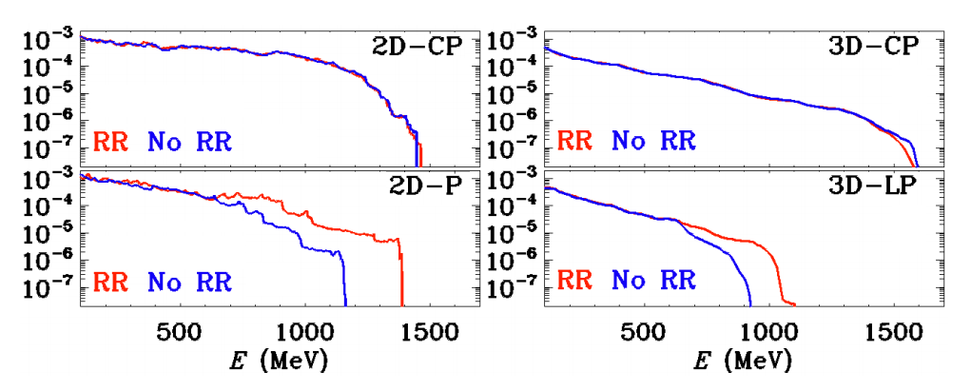
Multidimensional effects
Theory
Target transverse expansion $⇒$ «lighter» foil
$𝓔_{p}\left(t\right)\sim$ 1D: ${(Ω t)}^{1/3}$ 2D: ${(Ω t)}^{1/2}$ 3D: ${(Ω t)}^{3/5}$
$𝓔_{p}$_{max}: (3D) > (2D) > (1D)
linear polarization is detrimental
Laser pulse bends the target and gets «wrapped»
PIC results
Tamburini PRE 85 (2012)
Notes:
Controllare Bulanov

Slide 8
3D: 400k CPU Hours/sim. 16k CPU @ FERMI Cineca
$4096 ×1792×1792$grid $2⋅{10}^{10}$ macroparticles
CP laser: $I_{0}=1,7⋅{10}^{23}W/{{cm}^{2}} w_{0}=3,5μm τ=24fs λ=0,8μm$
H⁺ plasma (A) or C⁶⁺ plasma (B): $l=0,8μm n_{e}=64n_{c}$

Slide 9
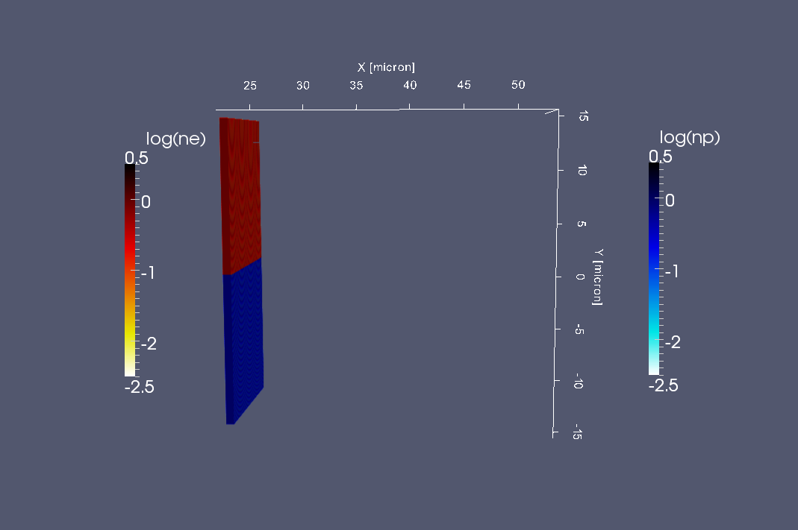
$$A)$$
$t=0$fs
CP laser: $I_{0}=1,7⋅{10}^{23}W/{{cm}^{2}} w_{0}=3,5μm τ=24fs λ=0,8μm$
e-p plasma: $l=0,8μm n_{e}=64n_{c}$

Slide 10
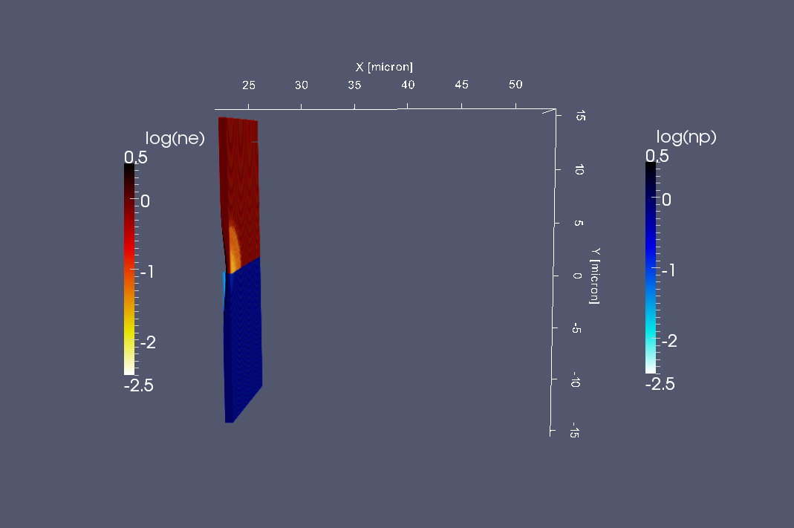
$$A)$$
$t=16,6$fs
CP laser: $I_{0}=1,7⋅{10}^{23}W/{{cm}^{2}} w_{0}=3,5μm τ=24fs λ=0,8μm$
e-p plasma: $l=0,8μm n_{e}=64n_{c}$

Slide 11
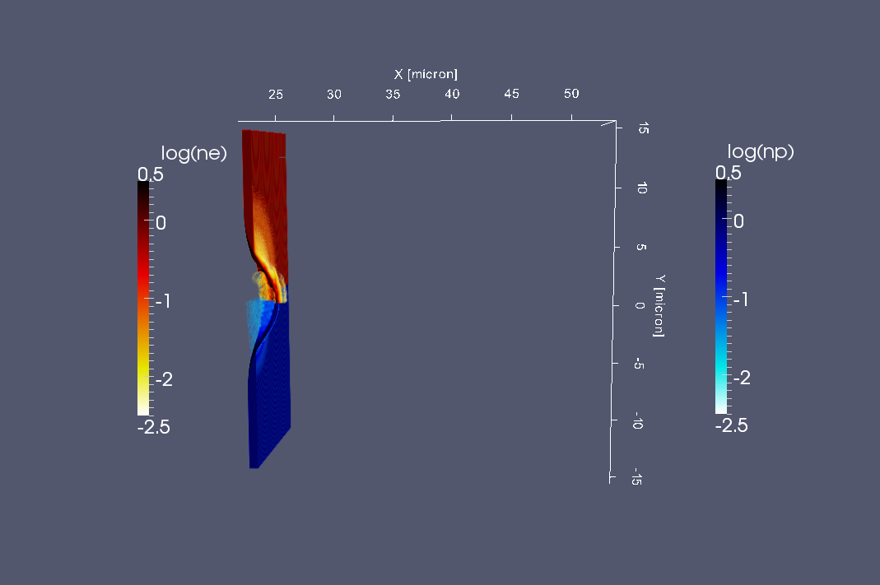
3D results figures
$$A)$$
$t=33,3$fs
CP laser: $I_{0}=1,7⋅{10}^{23}W/{{cm}^{2}} w_{0}=3,5μm τ=24fs λ=0,8μm$
e-p plasma: $l=0,8μm n_{e}=64n_{c}$

Slide 12
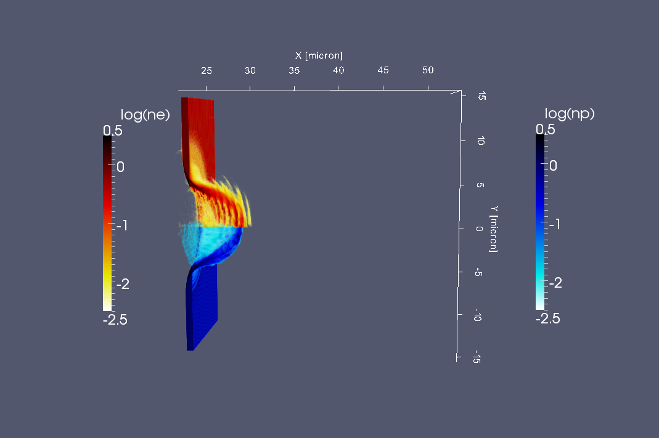
3D results figures
$$A)$$
$t=50$fs
CP laser: $I_{0}=1,7⋅{10}^{23}W/{{cm}^{2}} w_{0}=3,5μm τ=24fs λ=0,8μm$
e-p plasma: $l=0,8μm n_{e}=64n_{c}$

Slide 13
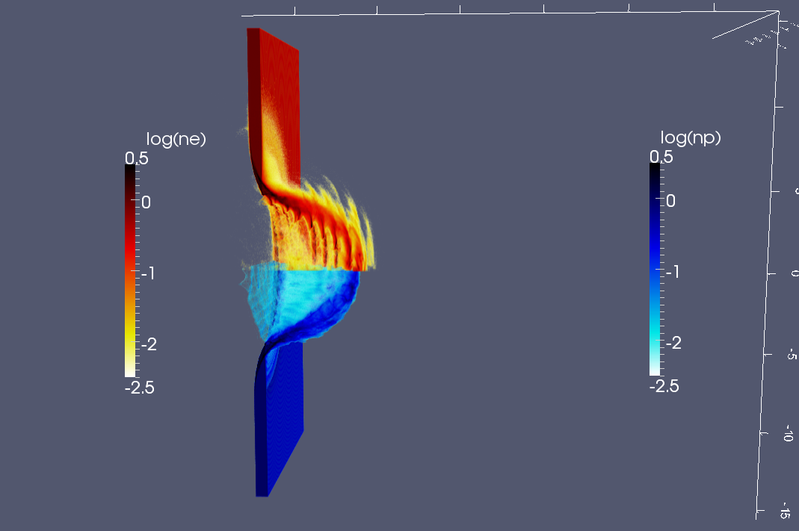
3D results figures
$$A)$$
$t=50$fs
CP laser: $I_{0}=1,7⋅{10}^{23}W/{{cm}^{2}} w_{0}=3,5μm τ=24fs λ=0,8μm$
e-p plasma: $l=0,8μm n_{e}=64n_{c}$

Slide 14
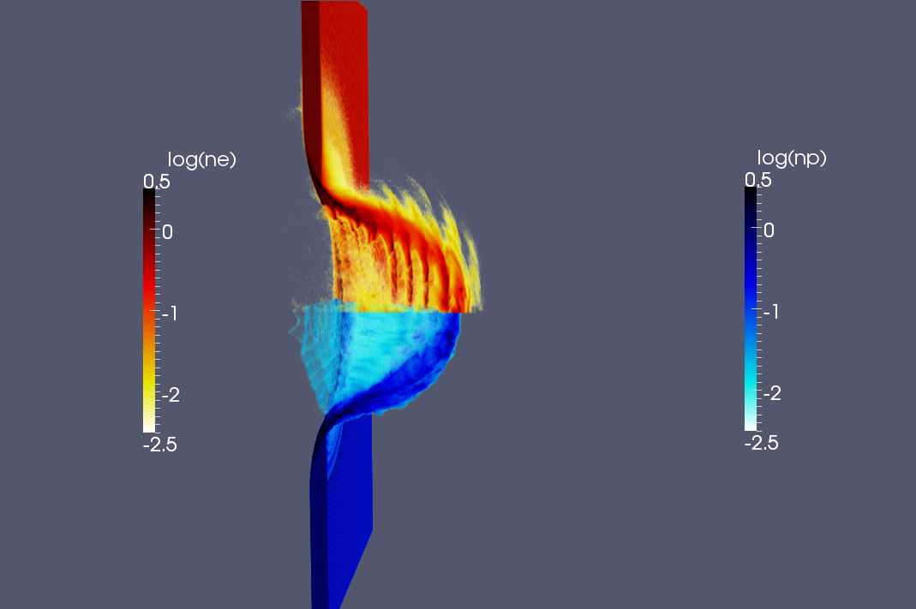
3D results figures
$$A)$$
$t=50$fs
CP laser: $I_{0}=1,7⋅{10}^{23}W/{{cm}^{2}} w_{0}=3,5μm τ=24fs λ=0,8μm$
e-p plasma: $l=0,8μm n_{e}=64n_{c}$

Slide 15
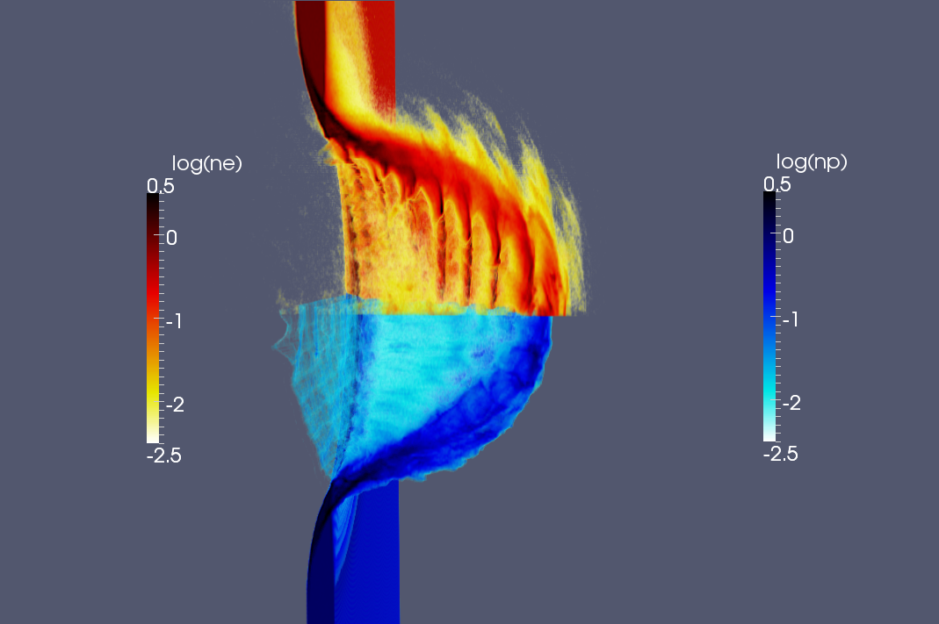
3D results figures
$$A)$$
$t=50$fs
CP laser: $I_{0}=1,7⋅{10}^{23}W/{{cm}^{2}} w_{0}=3,5μm τ=24fs λ=0,8μm$
e-p plasma: $l=0,8μm n_{e}=64n_{c}$

Slide 16
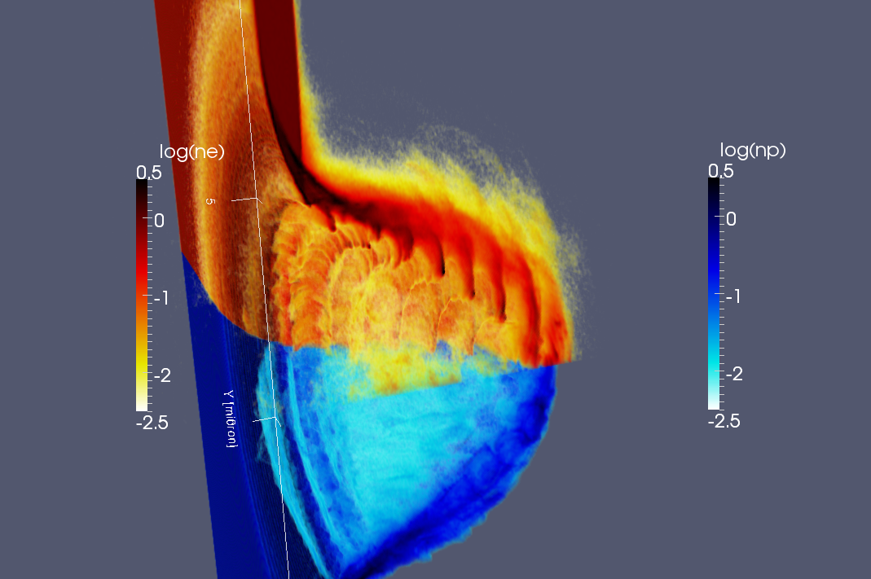
3D results figures
$$A)$$
$t=50$fs
CP laser: $I_{0}=1,7⋅{10}^{23}W/{{cm}^{2}} w_{0}=3,5μm τ=24fs λ=0,8μm$
e-p plasma: $l=0,8μm n_{e}=64n_{c}$

Slide 17
3D results figures
$$A)$$
$t=50$fs
CP laser: $I_{0}=1,7⋅{10}^{23}W/{{cm}^{2}} w_{0}=3,5μm τ=24fs λ=0,8μm$
e-p plasma: $l=0,8μm n_{e}=64n_{c}$

Slide 18
3D results figures
$$A)$$
$t=50$fs
CP laser: $I_{0}=1,7⋅{10}^{23}W/{{cm}^{2}} w_{0}=3,5μm τ=24fs λ=0,8μm$
e-p plasma: $l=0,8μm n_{e}=64n_{c}$

Slide 19
3D results figures
$$A)$$
$t=50$fs
CP laser: $I_{0}=1,7⋅{10}^{23}W/{{cm}^{2}} w_{0}=3,5μm τ=24fs λ=0,8μm$
e-p plasma: $l=0,8μm n_{e}=64n_{c}$

Slide 20
3D results figures
$$A)$$
$t=50$fs
CP laser: $I_{0}=1,7⋅{10}^{23}W/{{cm}^{2}} w_{0}=3,5μm τ=24fs λ=0,8μm$
e-p plasma: $l=0,8μm n_{e}=64n_{c}$

Slide 21
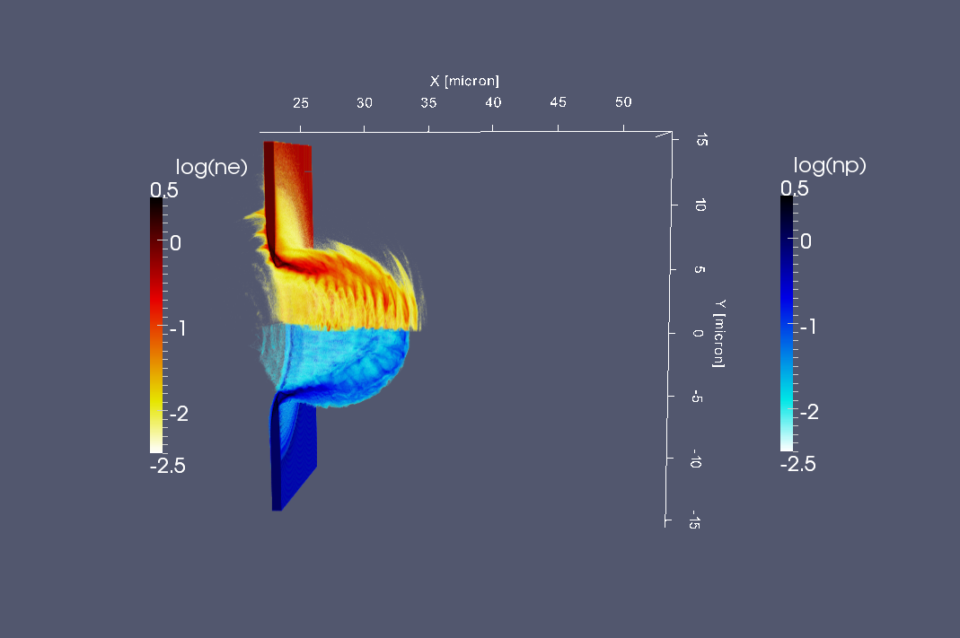
3D results figures
$$A)$$
$t=66,6$fs
CP laser: $I_{0}=1,7⋅{10}^{23}W/{{cm}^{2}} w_{0}=3,5μm τ=24fs λ=0,8μm$
e-p plasma: $l=0,8μm n_{e}=64n_{c}$

Slide 22
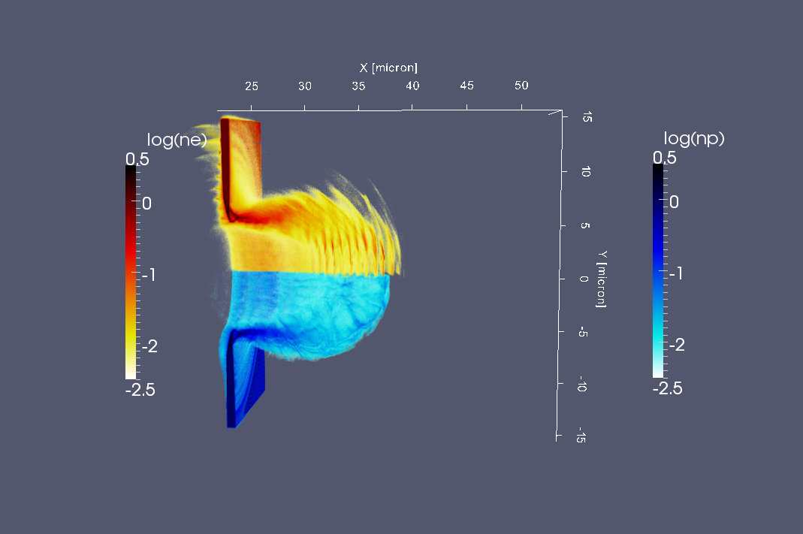
3D results figures
$$A)$$
$t=83,3$fs
CP laser: $I_{0}=1,7⋅{10}^{23}W/{{cm}^{2}} w_{0}=3,5μm τ=24fs λ=0,8μm$
e-p plasma: $l=0,8μm n_{e}=64n_{c}$

Slide 23
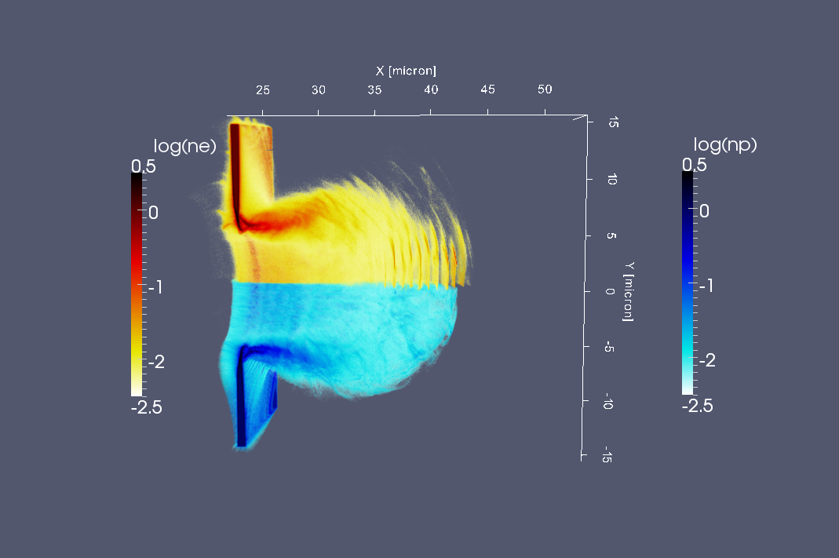
3D results figures
$$A)$$
$t=100$fs
CP laser: $I_{0}=1,7⋅{10}^{23}W/{{cm}^{2}} w_{0}=3,5μm τ=24fs λ=0,8μm$
e-p plasma: $l=0,8μm n_{e}=64n_{c}$

Slide 24
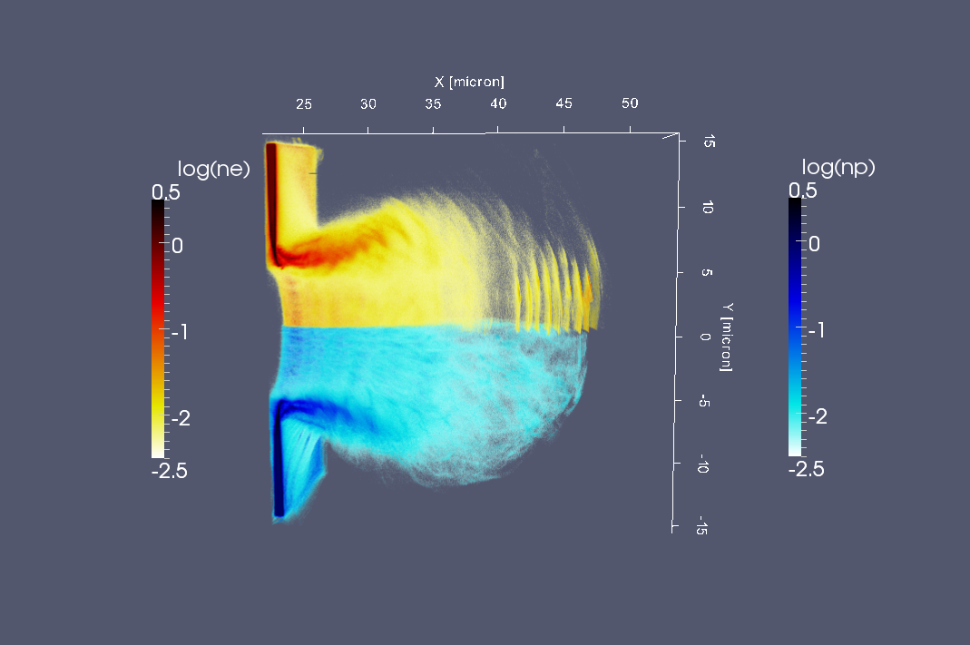
3D results figures
$$A)$$
$t=116$fs
CP laser: $I_{0}=1,7⋅{10}^{23}W/{{cm}^{2}} w_{0}=3,5μm τ=24fs λ=0,8μm$
e-p plasma: $l=0,8μm n_{e}=64n_{c}$

Slide 25
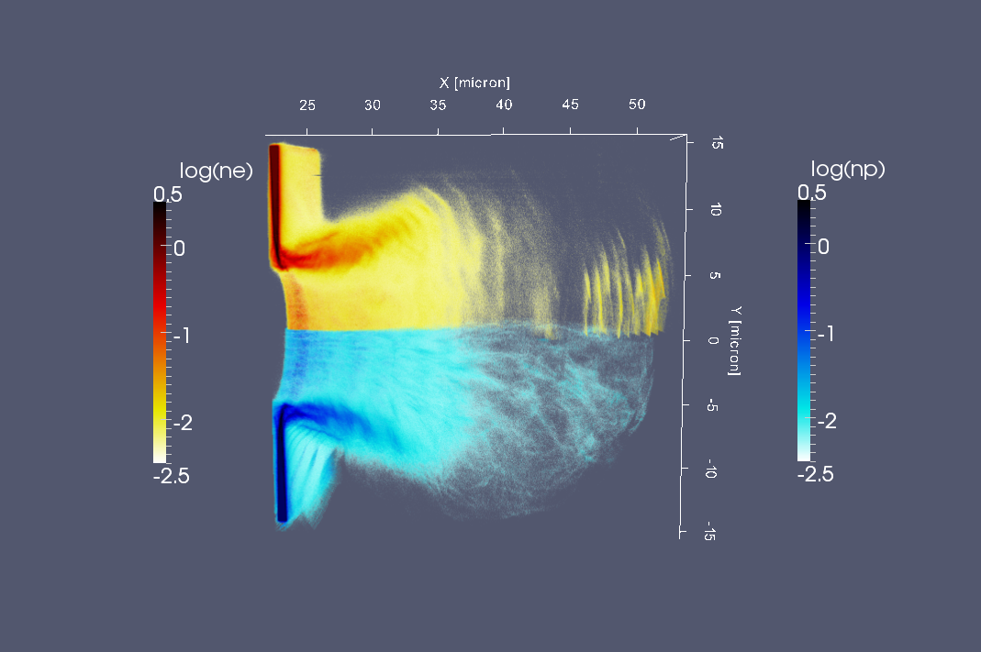
3D results figures
$$A)$$
$t=133$fs
CP laser: $I_{0}=1,7⋅{10}^{23}W/{{cm}^{2}} w_{0}=3,5μm τ=24fs λ=0,8μm$
e-p plasma: $l=0,8μm n_{e}=64n_{c}$

Slide 26
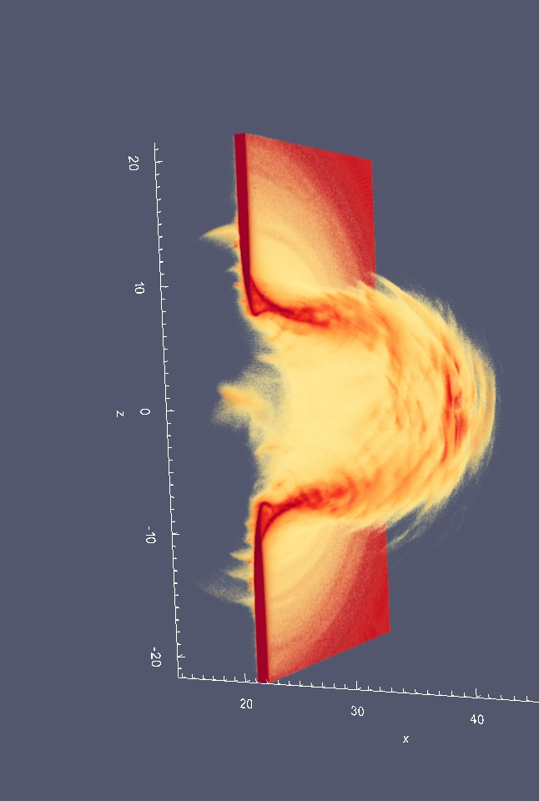
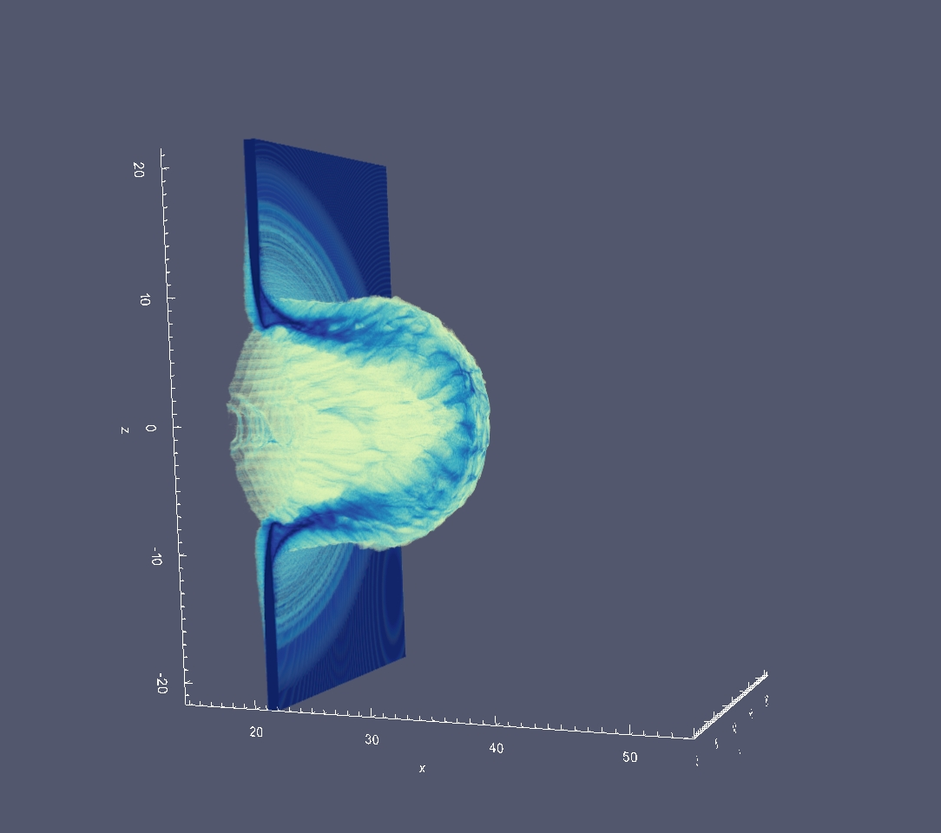
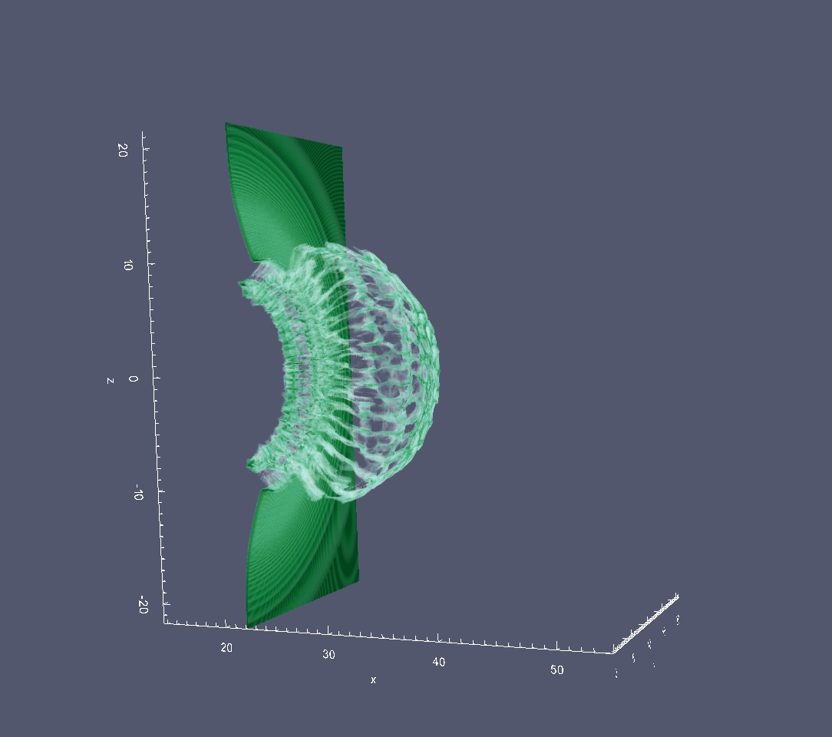
B) C⁶⁺ + H⁺ contaminants
CP laser: $I_{0}=1,7⋅{10}^{23}W/{{cm}^{2}} w_{0}=3,5μm τ=24fs λ=0,8μm$
electrons
carbon ions
proton contaminants

Slide 27
$$B)$$
$t=100$fs
C⁶⁺
H⁺

Slide 28
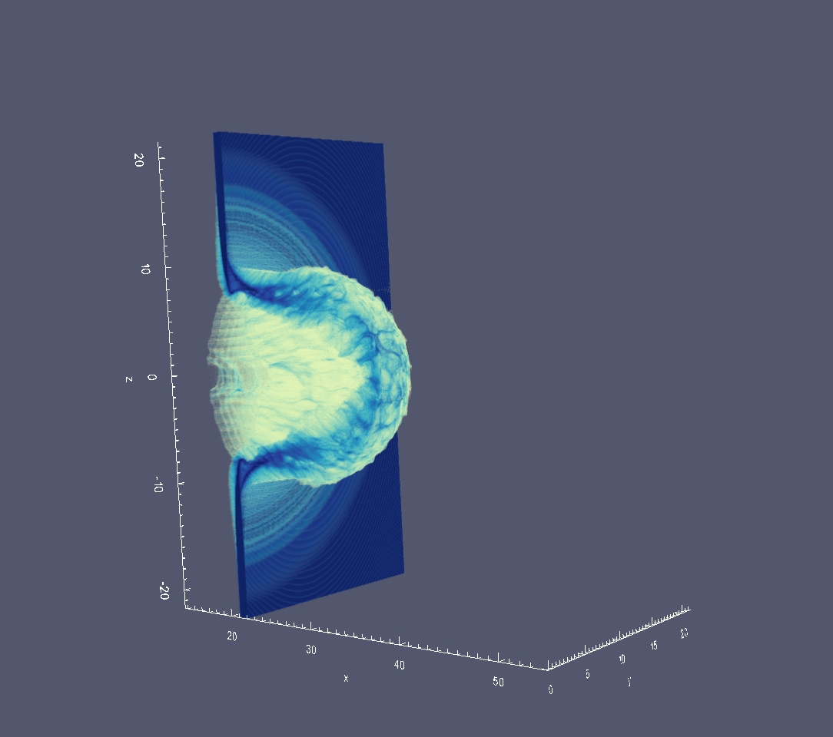
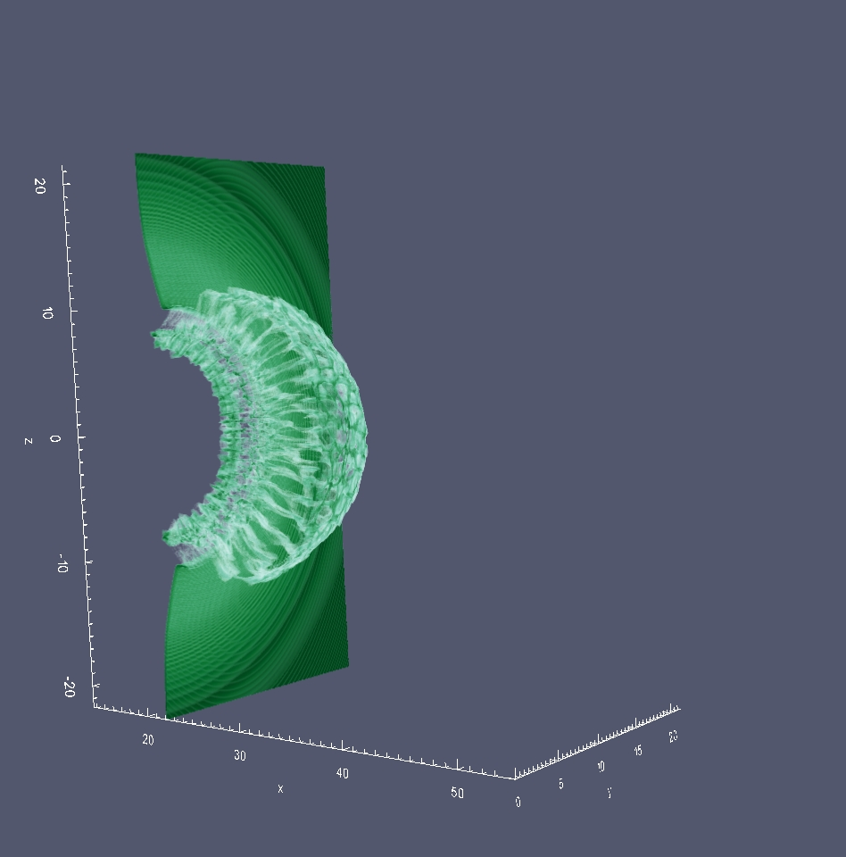
$$B)$$
$t=100$fs
C⁶⁺
H⁺

Slide 29
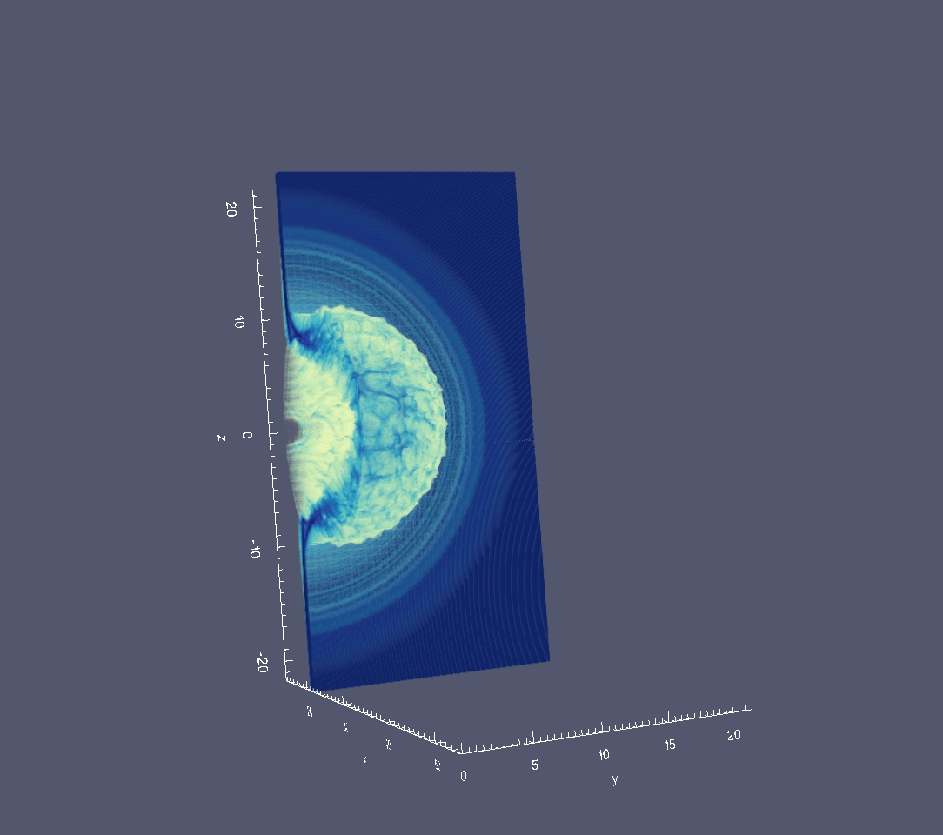
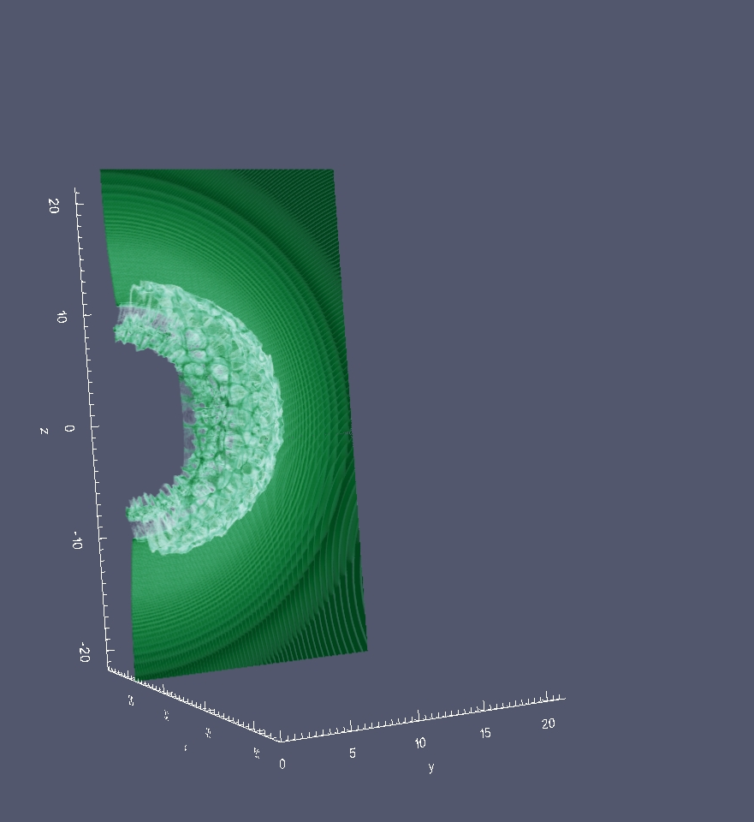
$$B)$$
$t=100$fs
C⁶⁺
H⁺

Slide 30
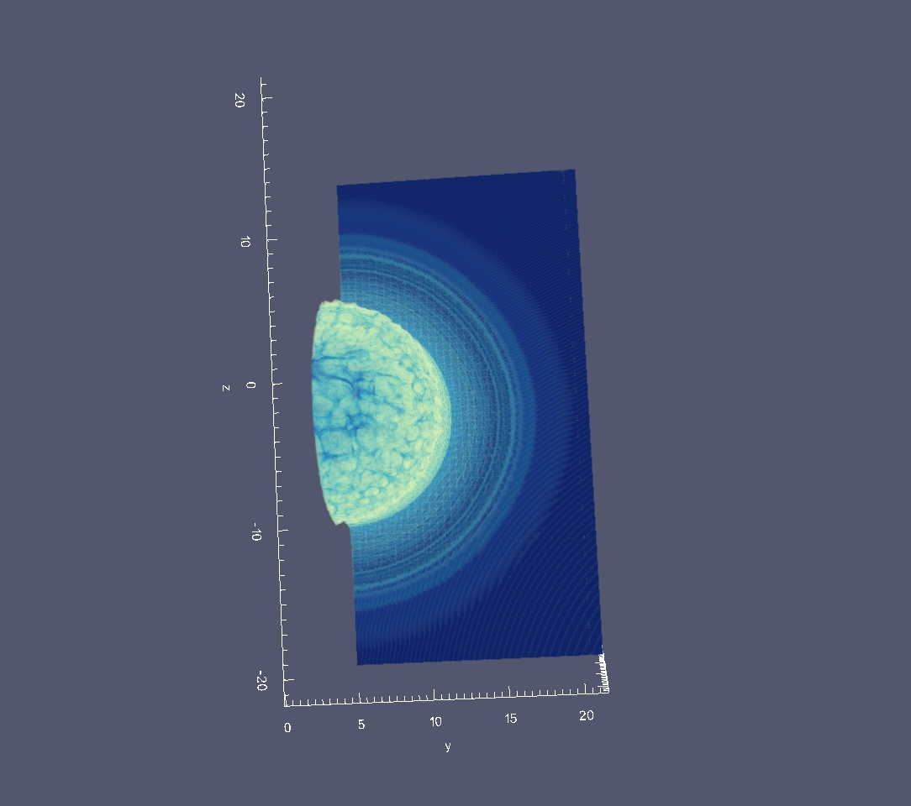
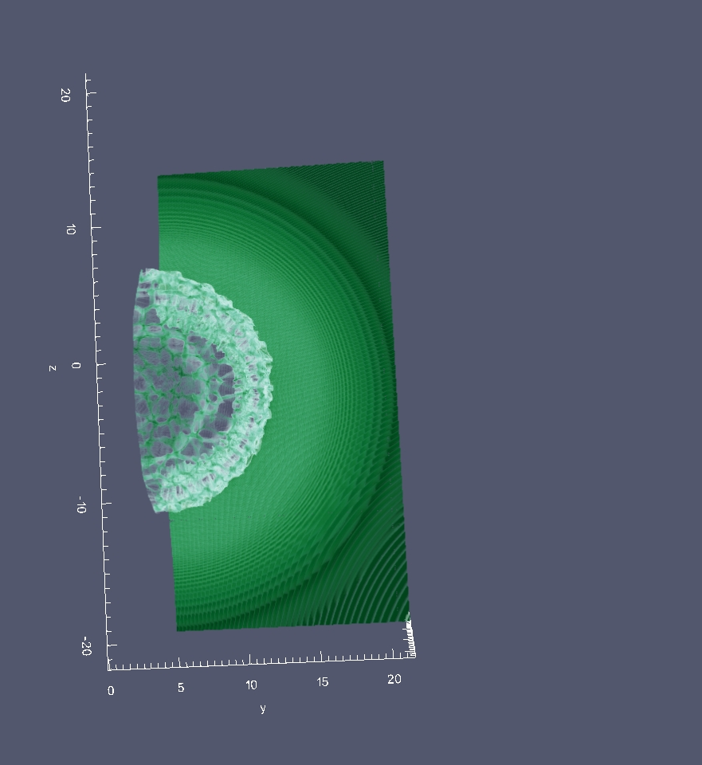
$$B)$$
$t=100$fs
C⁶⁺
H⁺

Slide 31
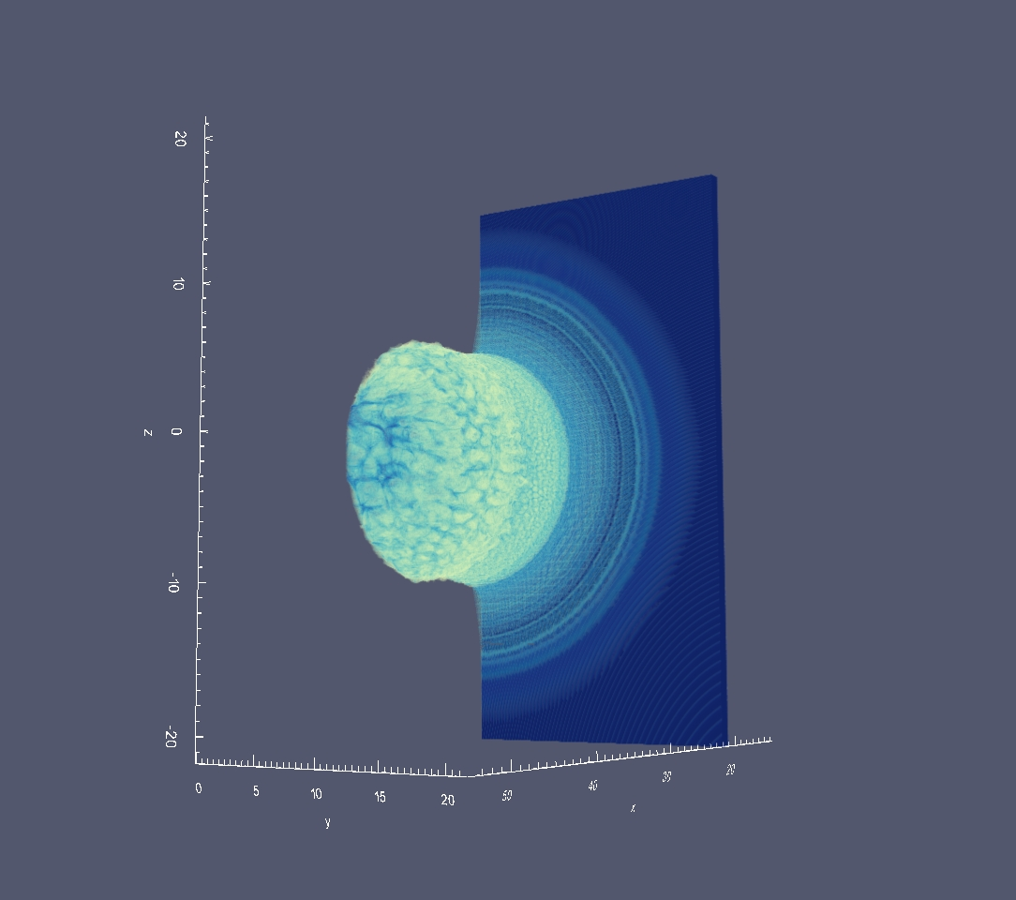
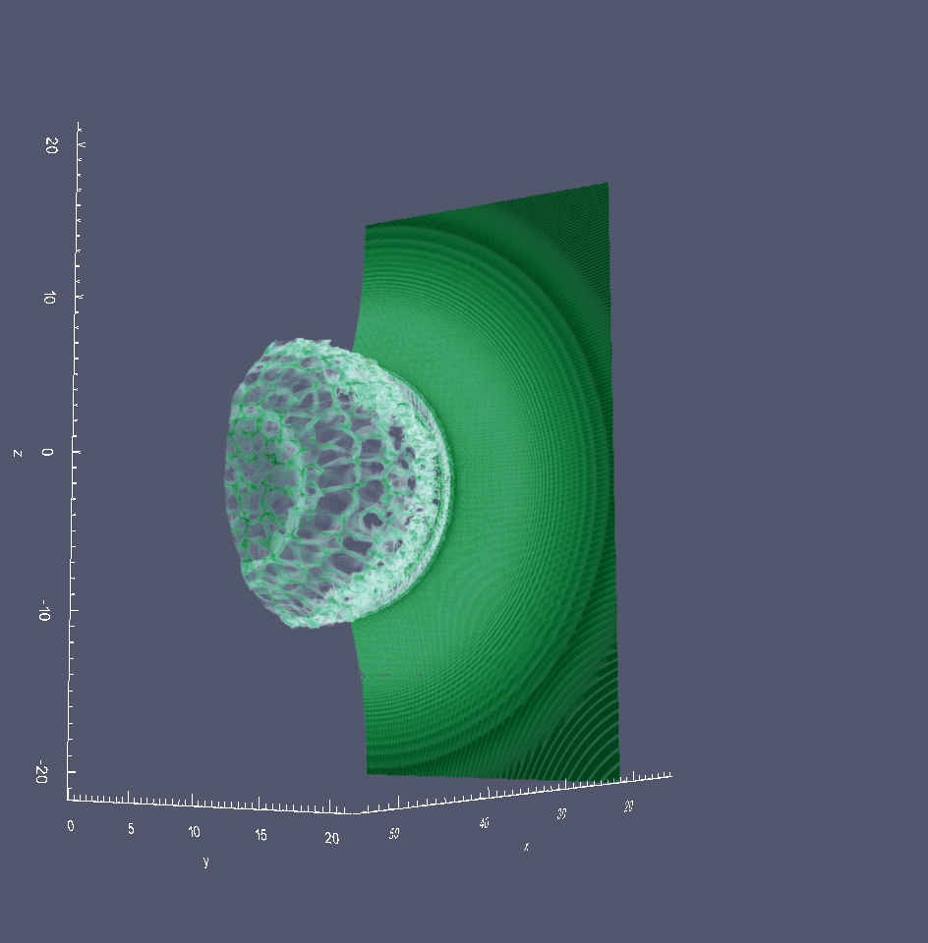
$$B)$$
$t=100$fs
C⁶⁺
H⁺

Slide 32
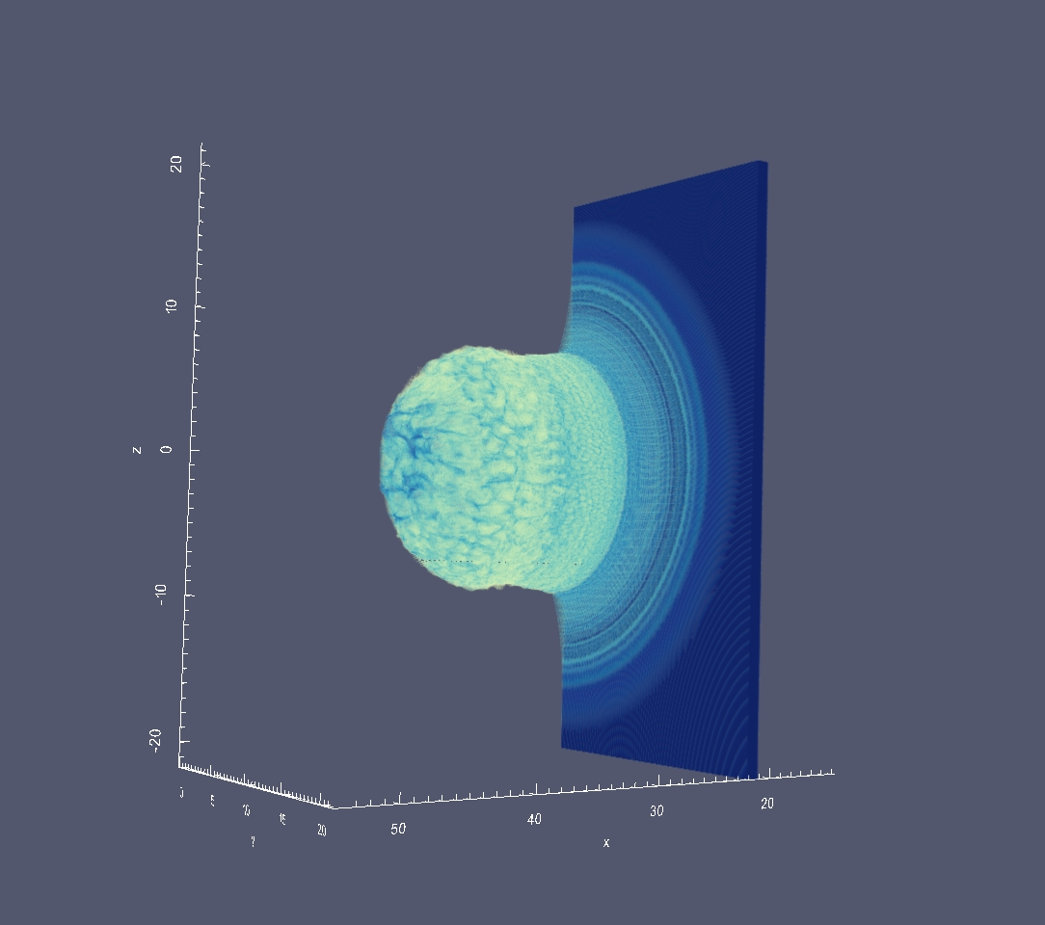
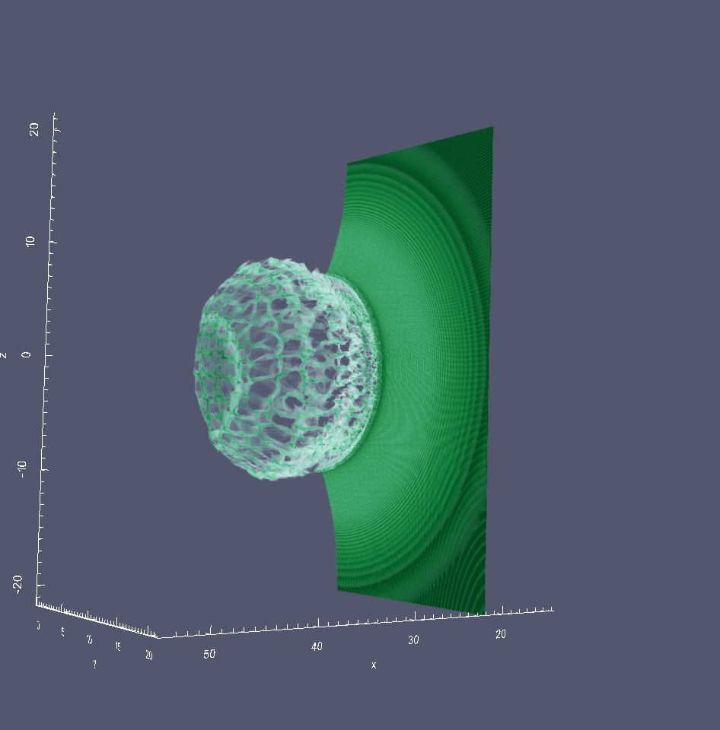
$$B)$$
$t=100$fs
C⁶⁺
H⁺

Slide 33
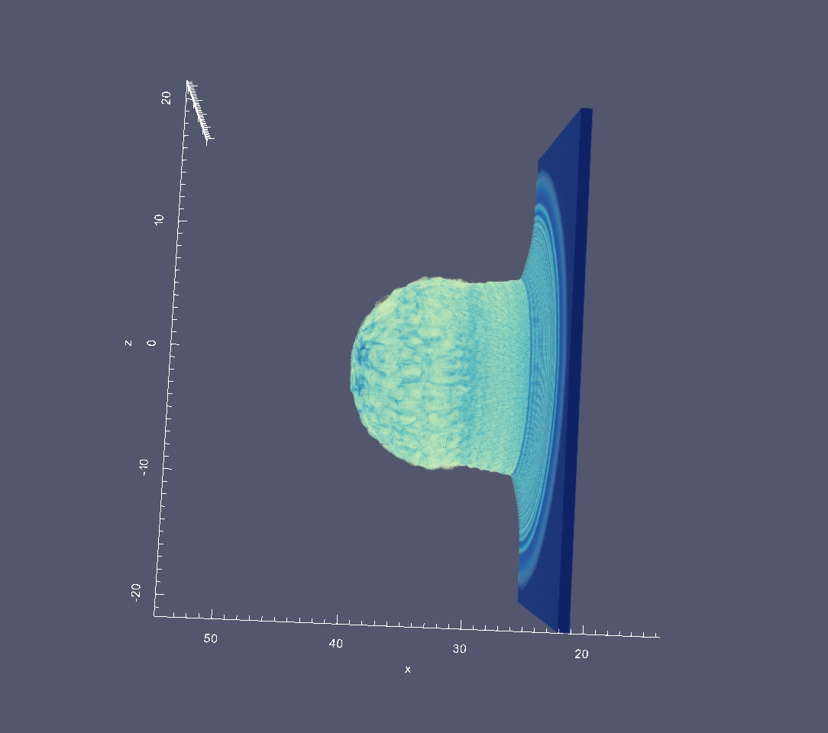
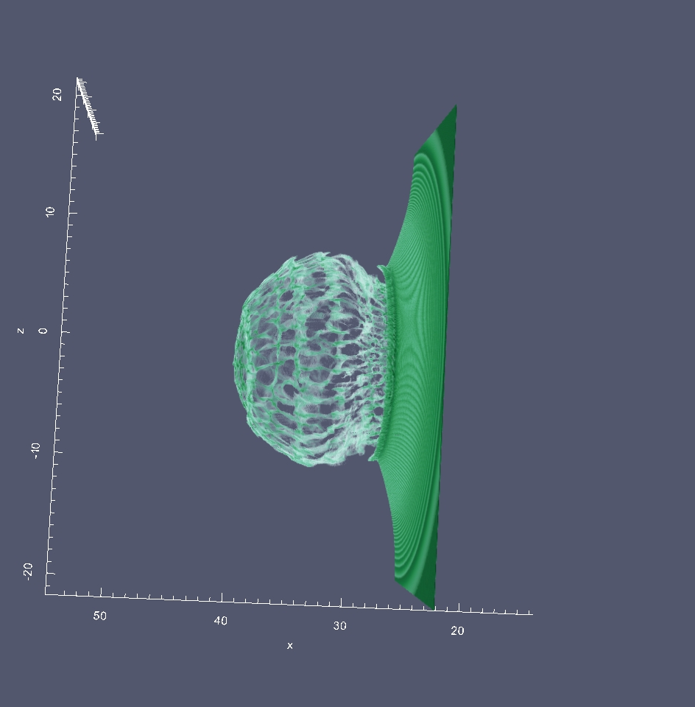
$$B)$$
$t=100$fs
C⁶⁺
H⁺

Slide 34
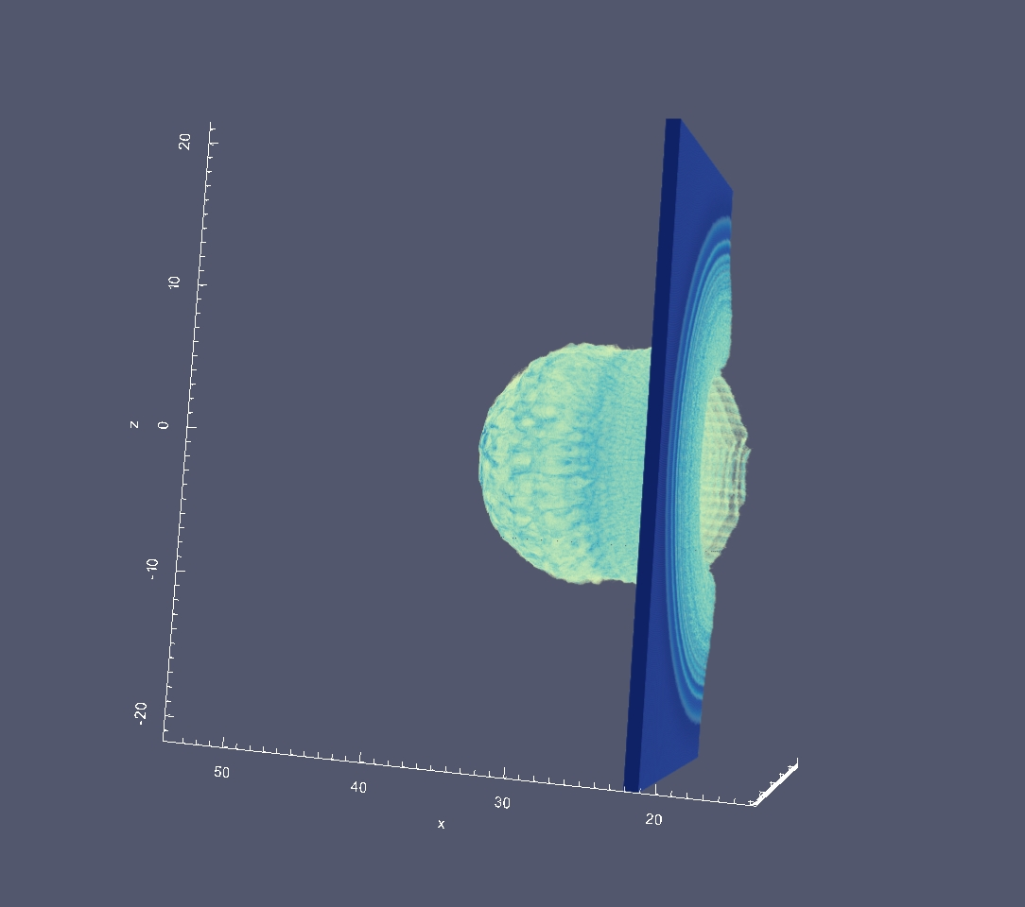
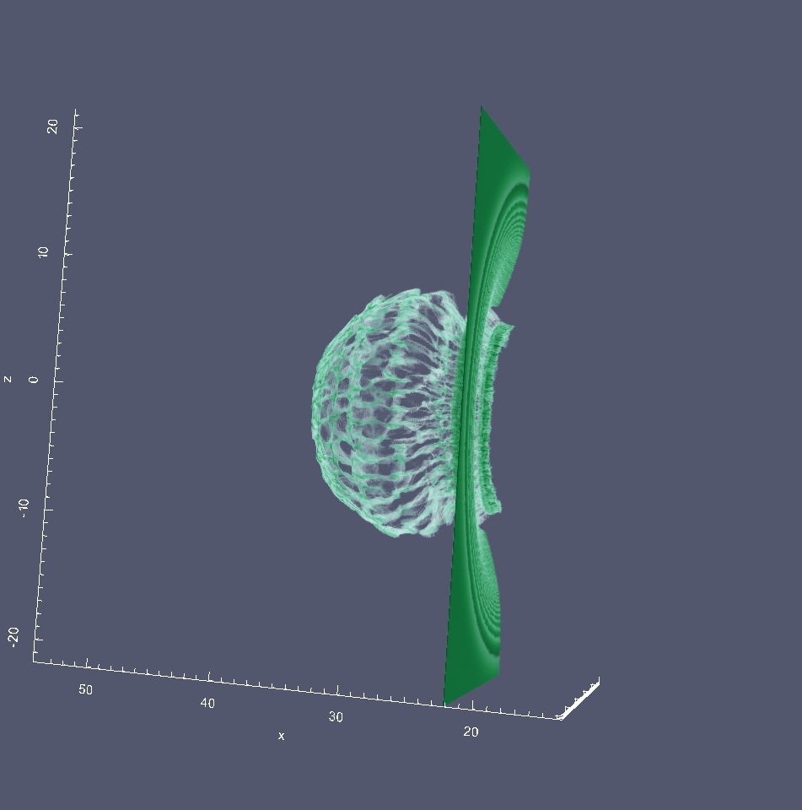
$$B)$$
$t=100$fs
C⁶⁺
H⁺

Slide 35
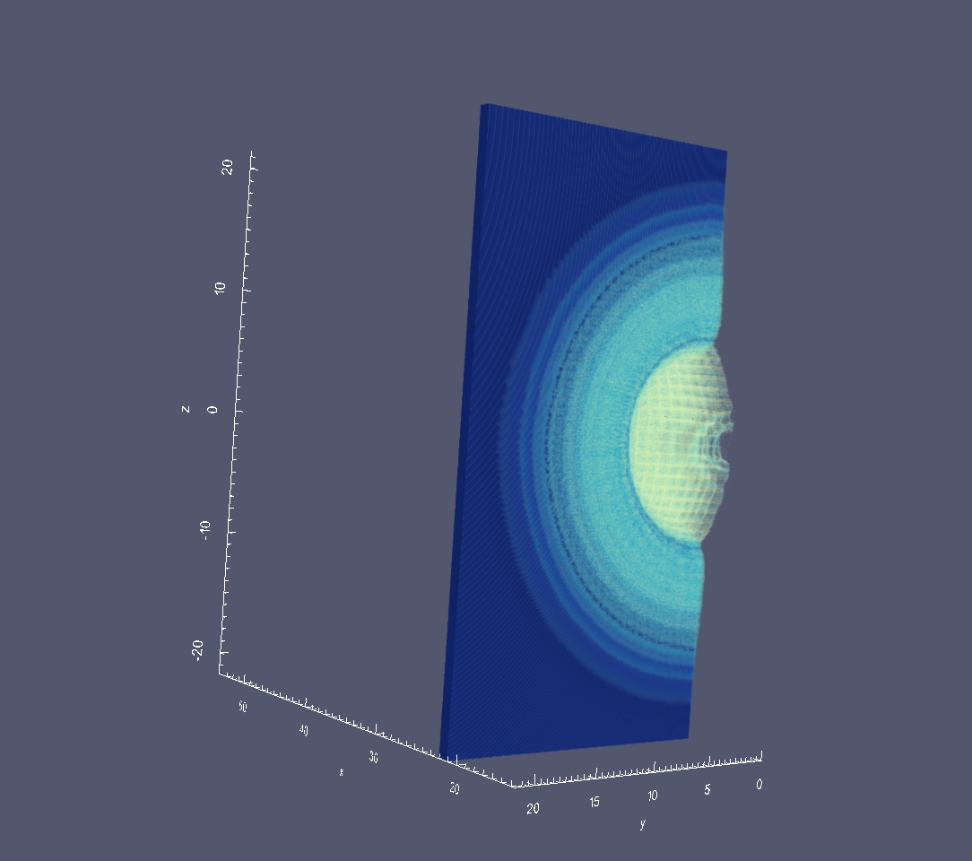
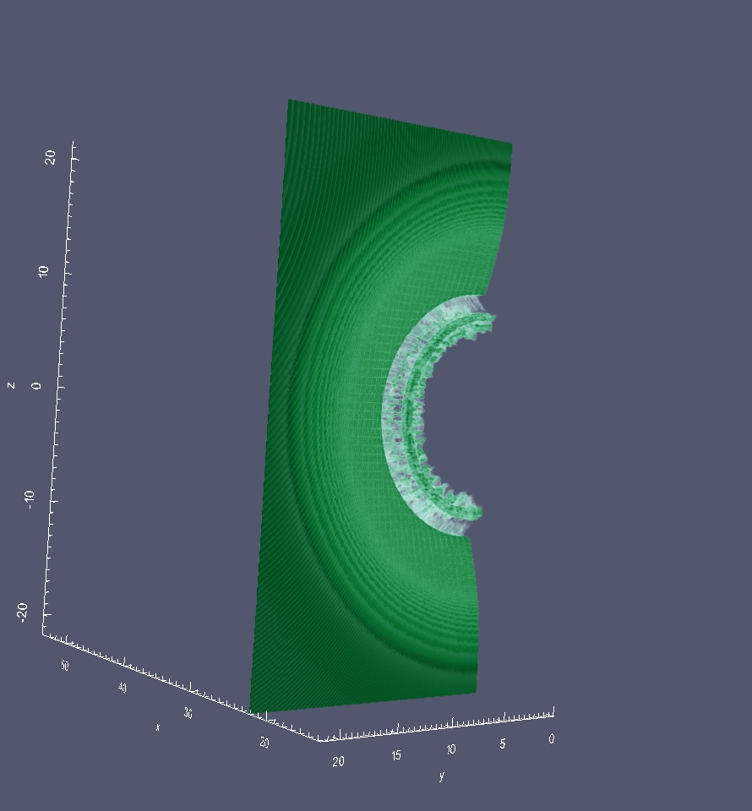
$$B)$$
$t=100$fs
C⁶⁺
H⁺

Slide 36
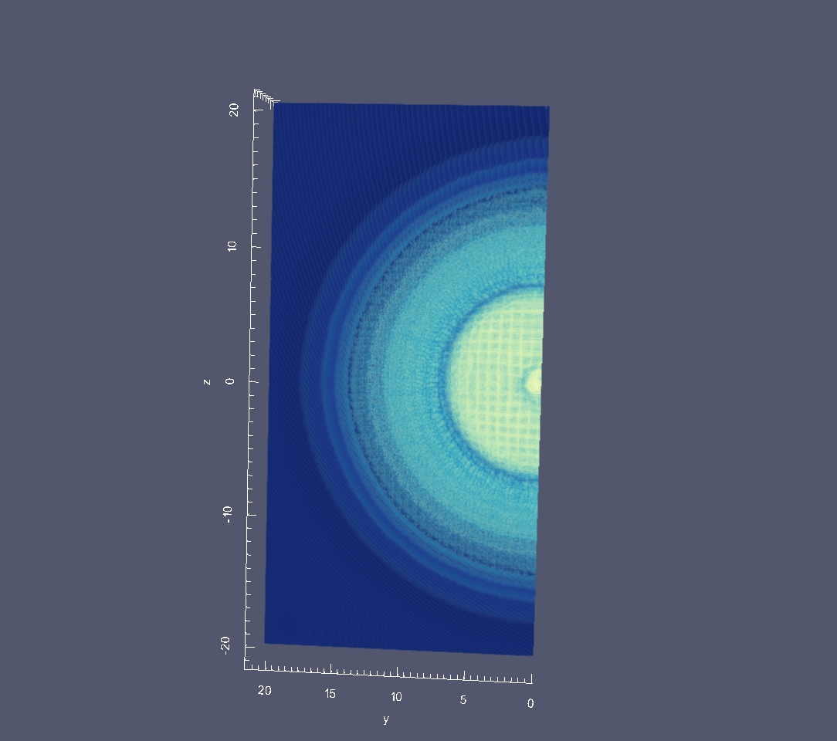
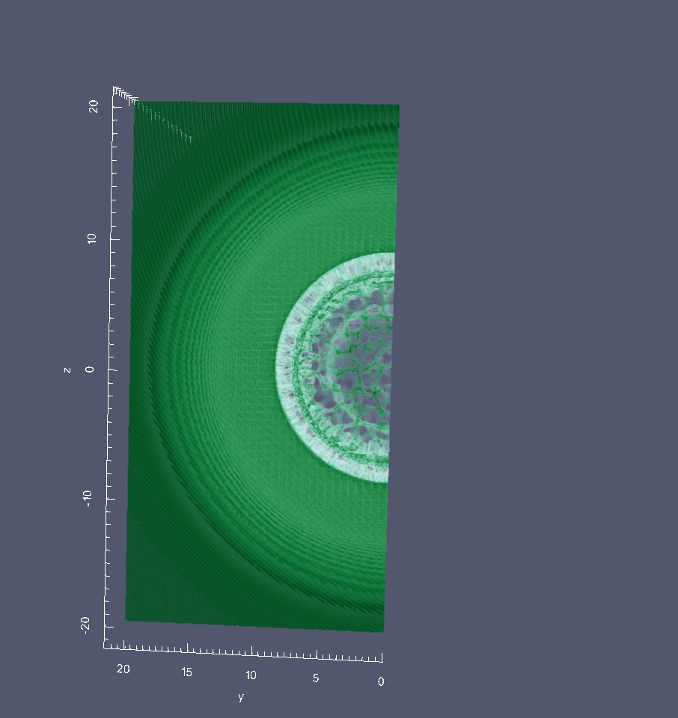
$$B)$$
$t=100$fs
C⁶⁺
H⁺

Slide 37
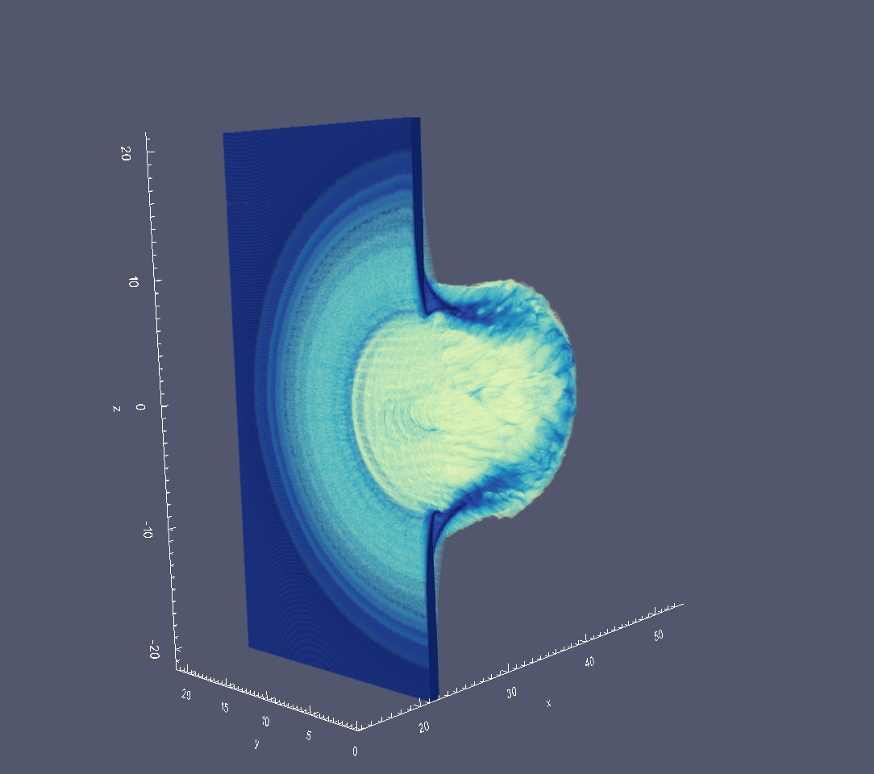
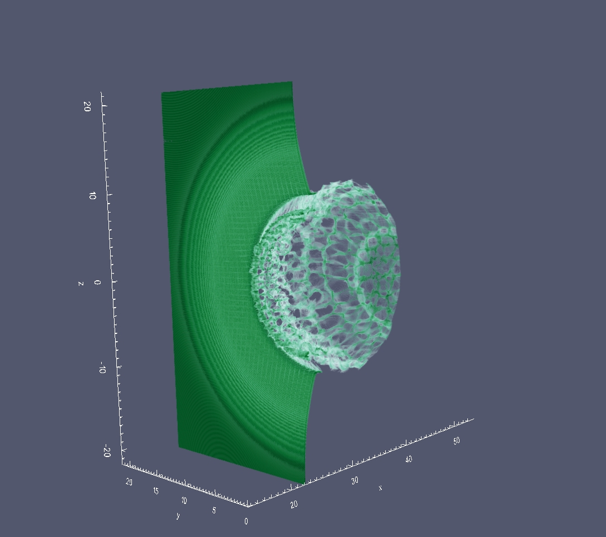
$$B)$$
$t=100$fs
C⁶⁺
H⁺

Slide 38
$$B)$$
$t=100$fs
C⁶⁺
H⁺

Slide 39
RCF - simulation

Slide 40
RPA-driven Raileigh-Taylor Instability
Plane wave on «wavy» target
P and Cicular pol.: stronger EM field on valleys
Higher pressure on valleys
Positive feedback deepens the perturbations
Spontaneous simmetry breaking

Slide 41
RPA-driven Raileigh-Taylor Instability: 2D theory
Plane wave (P, S, Circular Pol) on plasma slab
q: wave number of the surface perturbation k: the laser wave number
linear growth rate of q modes for a thin foil

Slide 42
New open source EM PIC code github.com/ALaDyn/piccante A. Sgattoni L. Fedeli S. Sinigardi
From the experience with ALaDyn
Rewritten in C++
Driving goal: high flexibility, easy to mantain
Very modular: easy to define
n-charged species and complex plasma configurations
n-laser pulses with arbitrary
flexible output

Slide 43
2D simulations: slab geometry
Fourier analysis of the excited modes
Electron density
Cutoff @ q=2k
Growth of the modes q=[1-2]k
Ion density

Slide 44
3D simulations: slab geometry
Circular polarization: Honeycomb-like structures p6mm symmetry
Linear polarization destroys all structures on the polarization direction
Bénard cell in clouds

Slide 45
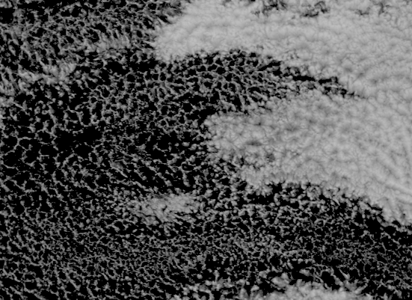
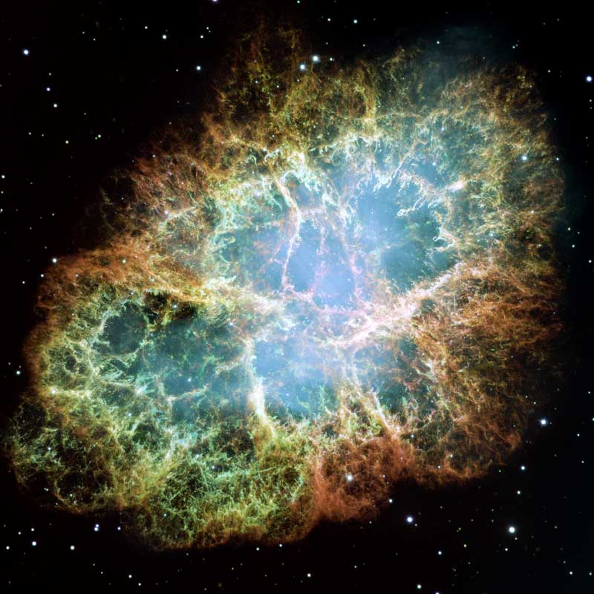
Crab Nebula: Hubble Space telescope (2005)
Africa west coast
Open and closed Bénard Cells
Meteosat-7 (2001)

Slide 46
RPA –Light Sail conclusions
1D theory
High intensity laser + thin dense plasma $⇒$ flying mirror
Target opacity is required
Critical issues
Laser tight focus may be detrimental
Slow energy scaling with time
Bulanov scaling seems confirmed: $ℰ_{u}$^{3D} > $ℰ_{u}$^{2D >} $ℰ_{u}$^{1D}
CP better than LP : better target integrity
PIC
results
3D on longer time-scales: Rayleigh length
Multispecies effects: i.e. Au+C+H plasma
long vs short laser pulses
Future works

