Slide 2
Beam dynamics studies for the LHC and Injectors upgrade: some examples
G. Arduini – Accelerator and Beam Physics Group
Beams Department
CERN

Slide 3
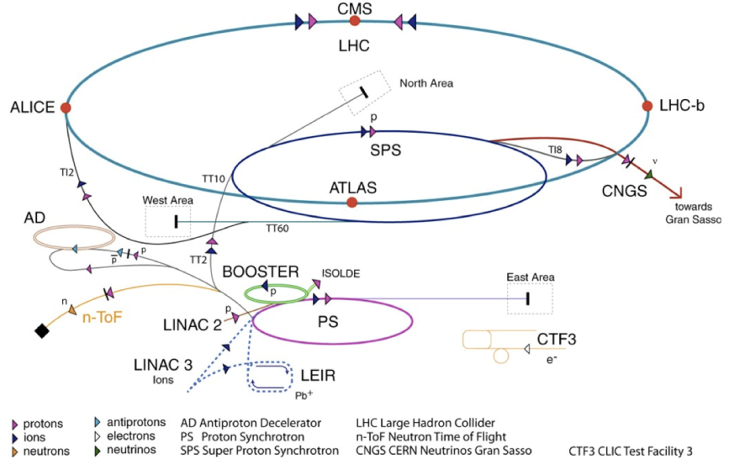
LHC accelerator complex
Beam 1
Beam 2
TI2
TI8
4 rings
 | Max. T [GeV]
LINAC2 | 0.050
Booster | 1.4
PS | 25
SPS | 449
LHC | 6999
LHC proton path

Slide 4
The European Strategy for Particle Physics
Update 2013
c) Europe’s top priority should be the exploitation of the full potential of the LHC, including the high-luminosity upgrade of the machine and detectors with a view to collecting ten times more data than in the initial design, by around 2030. This upgrade programme will also provide further exciting opportunities for the study of flavour physics and the quark-gluon plasma.
HL-LHC from a study to a PROJECT
300 fb⁻¹ → 3000 fb⁻¹
including LHC injectors upgrade LIU (Linac 4, Booster 2GeV, PS and SPS upgrade)

Slide 5
Why an LHC Upgrade?
Motivations:
Target (very ambitious) of the upgrade: 200 – 300 fb⁻¹/y (×10 today)
Radiation damage limit of IR quadrupoles (~400 fb⁻¹)
Radiation damage to detectors
2010-2012 experience:
Head-on beam-beam limit higher than initially expected
Single bunch with > 3x10¹¹ ppb with 2.5 μm emittance accelerated in the SPS
Low β* optics successfully tested in MD
Aim: run at pile-up/pile-up density limit of the experiments

Slide 6
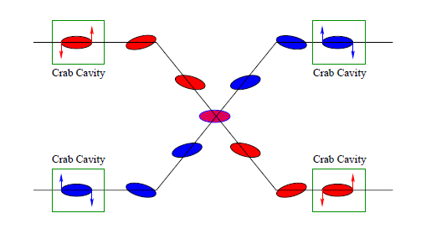
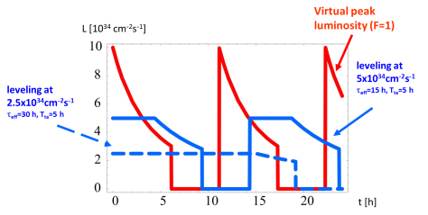
Ingredients for the Upgrade
Operation at pile-up/pile-up density limit:
choose parameters that allow higher than design pile-up
Low β*
Lower Emittance,
Higher Bunch population
Crab Cavities as tool to maximize overlap among colliding bunches (i.e. virtual luminosity) and minimize pile-up density
levelling mechanisms for controlling pile-up during fill
dynamic β* squeeze
F. Zimmermann

Slide 7
HL-LHC Parameters
3 x nominal brightness
Parameter | Nominal | 25ns – HL-LHC
Bunch population N_{b} [10¹¹] | 1.15 | 2.2
Normalized emittance ε_{n} [μm] | 3.75 | 2.5
Number of bunches | 2808 | 2748
Beam current [A] | 0.58 | 1.12
Crossing angle [μrad] | 300 | 590
Beam separation [σ] | 9.9 | 12.5
β* [m] | 0.55 | 0.15
Virtual Luminosity [10³⁴ cm⁻²s⁻¹] | 1.2 | 21.3
Max. Luminosity [10³⁴ cm⁻²s⁻¹] | 1 | 5.1
Levelled Pile-up/Pile-up density [evt. / evt./mm] | 26/0.2 | 140/1.25
Brightness preservation is a key issue all along the accelerator chain

Slide 8
LHC injectors upgrade
Present
LIU (2019)
The above beam requirements imply a major upgrade of the injectors:
PSB H⁻ injection @160 MeV with a new Linac (LINAC4). To reduce space charge effects at PSB injection.
Increase of the PSB-PS transfer energy 1.4 GeV ➔ 2 GeV to reduce space charge effects in the PS.
SPS RF power upgrade and vacuum chamber aC coating (to be confirmed) to reduce electron cloud effects in the SPS
Proton flux / Beam power
50 MeV
Linac2
Linac4
160 MeV
1.4 GeV
PSB
2.0 GeV
PSB
26 GeV
Output energy
PS
PS
450 GeV
SPS
LHC /
HL-LHC
7 TeV

Slide 9
LHC and Injector Upgrade: when?
During Run II and Run III we will be limited by heat load in the triplet (luminosity debris) and pile-up at the experiments
Every 3 of 4 year a long shutdown period is planned for upgrade activities
Run II: 13-14 TeV c.m. with levelled luminosity of <1.7x10³⁴ cm⁻² s⁻¹
Run III: 13-14 TeV c.m. with levelled luminosity of <1.7x10³⁴ cm⁻² s⁻¹
~5 months
Longer end-of-year stop (CMS)
LS2: 18 months
Connection of LINAC4
LHC Injectors Upgrade
ALICE, LHCb Upgrade
LS3: 30 months
High Luminosity LHC
Machine and Experiments

Slide 10
Main issues
Space charge effects in the injectors
Beam-beam effects in the LHC
Impedance and effect on beam stability in the injectors and LHC
Electron cloud in the SPS and LHC

Slide 11
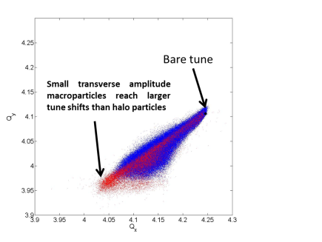
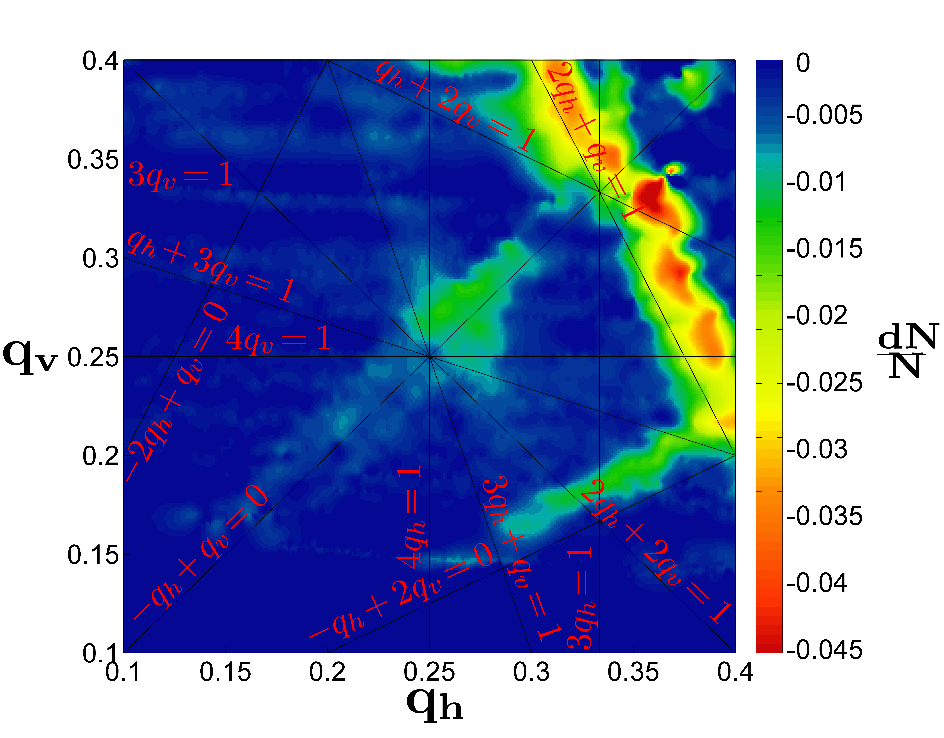
Space charge
Need to demonstrate we can run with ΔQ>|0.3| with limited emittance blowup (max 5%) in the PSB, PS and SPS. Requires:
Detailed machine model
Simulation tools to study the evolution of the beam distribution and of the corresponding tune footprint ➔ computing intensive
Intermediate approach: space charge frozen models in which hypothesis on the distributions are made
H. Bartosik, E. Benedetto, V. Forte, S. Gilardoni, R. Wasef

Slide 12
Computing time
# SC nodes: ~200
# macroparticles: 250k → 500k
For the PS Booster:
Time on our CERN cluster:
Chicane decay ~7ms=~ 7’000 turns → 8 hours
Benchmark with measurements ~200ms ~ 2x10⁵ turns→ >2 weeks (continuous tracking, i.e. dump & load for restart)
High intensity & emittance beams → x2 time (increase # macroparticles)
For the PS and SPS simulations should cover intervals of ~> 1-10 s corresponding to 5x10⁵ – 10⁶ turns but with a larger number of nodes

Slide 13
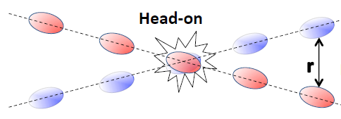
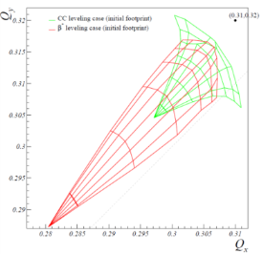
Beam-beam effects
T. Pieloni
Strong non linear fields when counter-rotating beams share vacuum chamber.
➔ spread in betatronic frequencies ➔ risk of overlapping resonances driven by magnetic errors
Head-on
$$∆Qbb∝\frac{Nb}{εn}$$
Long-range
S. Fartoukh

Slide 14
Beam-beam effects
Two approaches:
Weak strong simulations in which one beam has a constant distribution
Strong-strong simulations where the distribution of both beams are evolving.
Typical time scales ideally would be a few mins at least (~10⁶ turns) to extract information on intensity/luminosity lifetimes

Slide 15
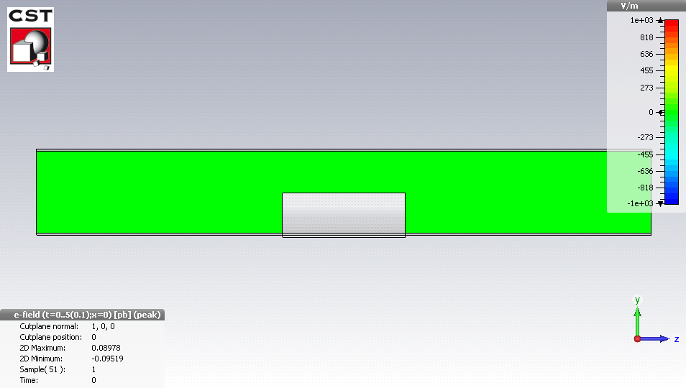
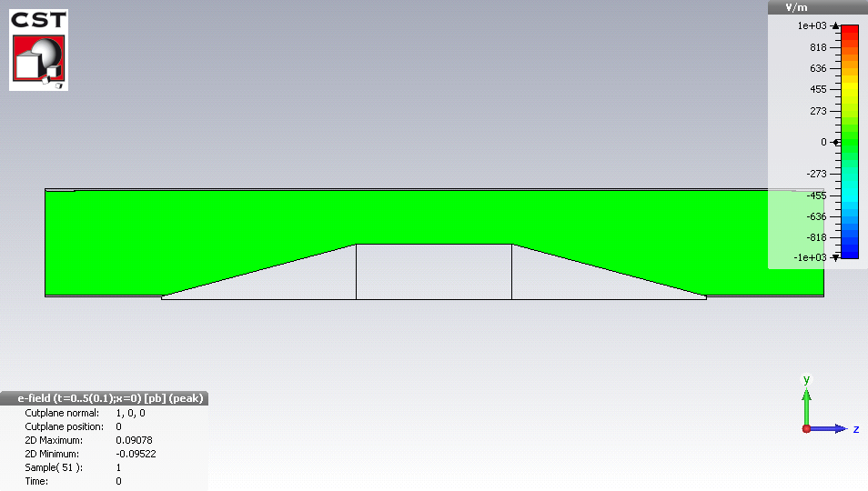
Wake fields and Impedances
Intense bunches generate electromagnetic fields when passing inside a structure (in particular C-collimators – opening of ~1 mm!!!)
→ results in an EM force, called wake field (in time domain) coupling with the beam
Avoid the abrupt transition for the beam fields at the location of the beam passage (taper)
Reduce the resistivity of the material
Abrupt transition
With taper
B. Salvant

Slide 16
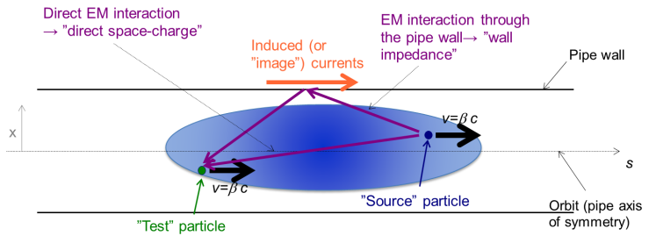
Wake fields and instabilities
Wake fields can couple the head and tail of a bunch or consecutive bunches leading to instabilities
~36 cm
~15 m
v
~2.2×10¹¹ p
s

Slide 17
Wake fields and instabilities
Two challenges:
Complex geometries for which we need an estimate of the wake field, extension of the wake field
Estimation of the bunch-by-bunch beam dynamics in the presence of impedances (and ideally of other effects, e.g. transverse feedback, non-linearities, beam-beam) for multi bunches (for the LHC ~2800 bunches) in time scales of a few seconds at least (~10000 turns)
M. Zobov et al. – INFN-LNF

Slide 18
Electron cloud effects
G. Iadarola, G. Rumolo
Secondary emission yield [SEY]
SEY>SEY_{th} ➔ avalanche effect (multipacting)
SEY_{th} depends on bunch spacing and population
Possible consequences:
instabilities, emittance growth, desorption, vacuum degradation, background
excessive energy deposition in the cold sectors
Electron bombardment of a surface has been proven to reduce secondary electron yield (SEY) of a material as a function of the delivered electron dose. This technique, known as scrubbing, provides a mean to suppress electron cloud build-up.

Slide 19
Electron cloud effects
Often complex geometries (e.g. two counter-rotating beams with offsets in the interaction region, octagonal beam screens, etc.)
So far the simulation of the build-up of the electrons along the bunch trains and of the bunch to bunch motion are dealt as separate processes.
Ideally we would like to get a self-consistent picture in which the impact of the bunch-by-bunch and intra-bunch motion on the electron cloud build-up is taken into account
2.1e11 ppb
G. Iadarola

Slide 20
Summary and Conclusion
The unprecedented value of the brightness of the beams required for the upgrade of the LHC and the tight tolerances in emittance blow-up demands more and more accurate models and simulation tools.
The simulation tools require:
Large computing power
Expertise to optimize the algorithms and better adapt them to the computing infrastructure.

