Slide 1
Storage Evolution
Ian Bird, CERN & WLCG
CNAF, 19th November 2015

Slide 2
High Level View
Today we have ~500 PB of storage (50% tape, 50% disk)
~60-70% of global WLCG spending is on disks!
BUT: observation is that lots of data on disk is:
Replicated very many times
Often not touched (ever)
Experiments find difficulty to make use of dispersed disk pools
Would rather have fewer, larger pools
Networks allow this now
Can we afford more compute, by saving on disk ??
Computing models evolving to allow far more remote data
E.g. how we use commercial clouds now relies on this
Anticipate evolution of roles of centres according to this model
Smaller Tier 2’s may become essentially “diskless” (except cache space)

Slide 3
Storage Evolution for WLCG
SRM
SRM more and more only being used to interact with tapes
Disk and Tape systems becoming separated (use groups schedule accesses)
Disk pools
Different cases
Large pools (dCache, EOS) and today DPM, Storm
Medium term storage – used for highly accessible and frequently accessed data
Smaller “caches” (today DPM, etc)
Used for temporary space – job caching for processing, analysis
Future model may emphasise large (semi-permanent) pools which need real management tools
Caches could simply be staging space accessed via http etc

Slide 4
Access Protocols
Today SRM, rfio, dcap, gridftp, xroot,
Can we move towards?
Xroot
https
(SRM if still needed for tape)

Slide 5
Other interesting topics
Sync’ing
CERN strategy for home directories/cernbox/physics data
Future of AFS
Main use case is replaced by CVMFS, no other remaining uses that require the global nature
Will never be IPV6 compliant – has a limited future
Use of federated identities for access (EduGain)

Slide 6
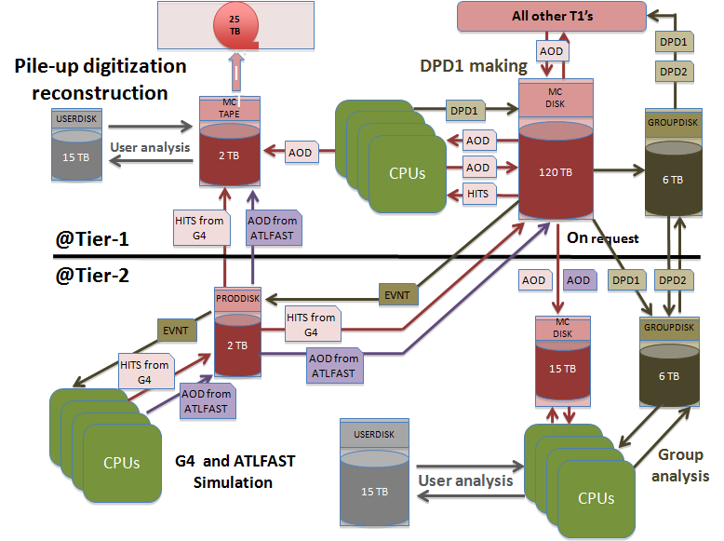
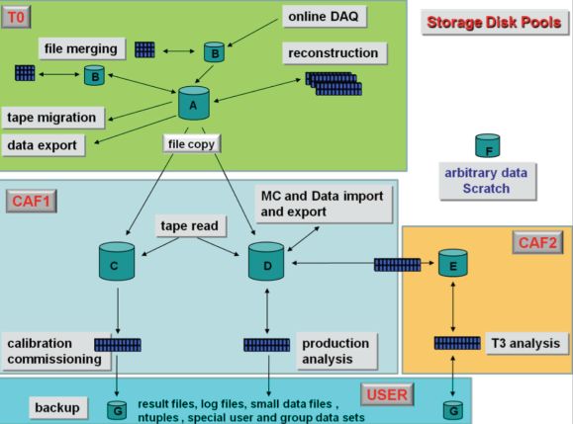
Vision for data management
Examples from LHC experiment data models
Two building blocks to empower data processing
Data pools with different quality of services
Tools for data transfer between pools

Slide 7
A flexible architecture
Disk pools (EOS)
Arbitrary reliability, Arbitrary performance, High scalability
Designed to sustain 1 KHz access
Main platform for Physics Analysis at CERN
Standard access interfaces
Tapes (CASTOR Tape Archive)
High reliability, Data Preservation
Low cost, High throughput
Fast and reliable
(expensive)
Cover the entire
area of requirements
Reliable
and Cheap
(high latency)
Fast and
cheap
(Unreliable)

Slide 8
Storage services for HEP
✓
achieved
✓
plan to improve
Meet (and anticipate) requirements for LHC experiments
Fast response to changing requirements
Arbitrary Reliability / Arbitrary Performance
Binary preservation, data archives, data integrity
Unlimited scalability (objects, nb of files, metadata, …)
Standard access methods and tools
HTTP protocol, mounted file system, tools for data transfers and synchronization (high throughput, high latency, unreliable networks,…)
Xroot guarantees maximum resource efficiency and performance
Ensures that our services can use directly standard industrial services
Ensure than other sciences can use directly our scientific services
✓
✓
✓
✓
✓
✓
✓
✓
✗✓

Slide 9
A global storage service…
Access to the whole storage repository
All Physics (and user) data at CERN
Access to WLCG / HTTP federated storage worldwide
Mounted online file access
On Linux, Mac : Use FUSE or WebDAV
On Windows : Webdav (…)
Synced offline file access
Supported on all platforms (Linux, Mac, Windows, IOS, Android)
Web browser file access
Available anywhere there is internet connectivity: Easy sharing to unregistered identities, Read/Write sharing, Bulk download
Programmatic, high performance, custom access
Xroot (and http) libraries for all relevant programming languages

Slide 10
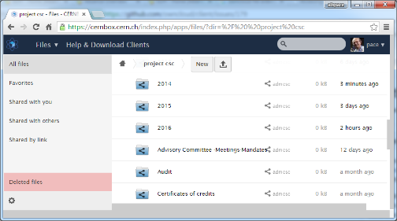
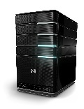
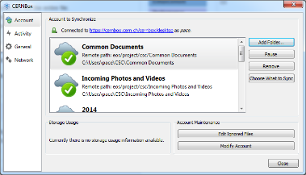
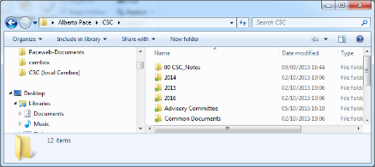
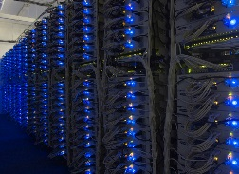
Architecture
Web browser access
(web access)
CERNBOX web interface
Sync client (CERNBOX)
(offline access)
http OC sync protocol
(Etag, X-OC-Mtime,
If-Match, OC-FileId)
Castor
Tape
Archive
Client
(online access)
http, fuse
Webdav,
xroot
Clusters (Batch. Plus, Zenodo, Analytics, …)
Disk Pools (EOS)
Application interfaces

Slide 11
CERN Plans for 2016
Operate storage services at the highest quality and availability
EOS as the strategic storage platform
New, scalable name server (+ 2 orders of magnitude)
Performance boost from new FUSE mount interface
CERNBOX as the strategic service to access EOS storage
New home directory service
Offer migration paths out of AFS (90% could go to EOS)
Evolve Castor to become “Tape Only”
CTA – “CASTOR/CERN Tape Archive”
Disk used only for internal data staging and buffers
Make the CERN storage infrastructure a showcase for scientific computing

Slide 12
CERN Plans for 2016
HTTP as a strategic data access protocol
XROOT remains for “custom high performance” access
Better and improved data transfer agents (FTS, …)
CEPH the backend storage solution
Based on commodity hardware
Used by Openstack, Filers, …
Hadoop
Consolidate the existing clusters
Hadoop on EOS ? Integrate with CERNBOX ?
Collaboration with PH-SFT on “analysis from the web browser”
Openlab
new collaborations in 2015: Seagate, Comtrade
new collaborations in the pipeline: DSI (?), Cloudera, …

Slide 13
FTS
Run2 Production > 2 million transfers/day
Continuous improvements
functionality (driven by experiments )
performance (dev. and infrastructure support)
WLCG deployments at CERN, RAL, BNL, Fermi
more transfers than FTS2, fewer instances
Zero config
Prototype implementation of Federated Identity management
WebFTS as a demonstrator, crucial for the future of grid services
CERNBox integration
S3 support demonstrated by BNL
DynaFed as a data bridge
Plans:
Intelligent transfer optimization
using advanced analytics techniques
Federated Identity
User driven improvements
Embedded FTS
FTS as an internal component for complex data and storage system

Slide 14
DPM and LFC
188 Instances managing 18% of WLCG data volume
DM-lite (DPM core)
performance improvements
config support for sites
SRM free operations
HTTP interface
Focus: Ease of maintenance and operation
LFC has been selected by Belle II (against our advice ;-) )
signed MoU
Plans:
Remove legacy code
ease maintenance and reduce potential security risks
Explore different strategies for caching and federated access
with the long term goal to gradually convert DPMs into caches

Slide 15
Access components
Dynafed
Canada ATLAS and LHCb for data federation
Volunteer computing for data bridge functionality
At BNL as a bridge to S3 storage
Cloud integration ( Vcycle for status reports )
Davix
Completion of Cloud support
S3, Azure, Ceph....
Verified performance on par with xroot for analysis
Johannes Elmsheuser for ATLAS at CHEP
Plans: Depend on uptake, reach out to other sciences

Slide 16
Convergence
For smaller sites, envisage (requested also by experiments) that less storage is located there
Mainly for caching, staging
Currently existing DPM instances can become caches
More lightweight “DPM”
Also trial EOS WAN clusters
i.e. a single head node with remote pools – reduces management needs at remote sites
Eventually converge these two views

Slide 17
Trends – Data centres
Moving data around the world to 100’s of sites is unnecessarily expensive
Much better to have large scale DC’s (still distributed but O(10) not O(100) ) – connected via v high bandwidth networks
Bulk processing capability should be located close or adjacent to these
Data access via the network – but in a truly “cloud-like” way – don’t move data out except the small data end-products

Slide 18
Client
Simulation Factory/HPC
DC
Compute
1-10 Tb/s
DC
Compute
DC
DC primarily academic, allow hybrid
Data replicated across all
Compute: commercial or private – cost/connectivity
Data input from external sources: instruments, simulation factories
Clients see as a single DC, access data products: existing, on-demand
Allows new types of analysis models
A Virtual Data Centre for Science?

Slide 19
Planning for HL-LHC
Foresee 2 technical activities:
Medium term (Run 2, Run 3)
Evolution of current models and infrastructure
Set up technical groups to study the various aspects
Longer term (Run 4)
Need some brainstorming of new ideas – current models will not be sufficient
Use WLCG workshop in February in Lisbon to initiate these activities
One day on each topic – set up groups
Anticipate being reviewed on this by LHCC starting in 2016
Computing is important component of upgrade costs

