Slide 1
INFN—Catania
Giuseppe Andronico
Bologna, 23 Gennaio 2014

Slide 2
Chi siamo?
Giuseppe Andronico
Salvatore Monforte
Maurizio Paone
Vanessa Privitera (borsa GARR)
Gianluca Passaro
Giuseppe Platania
Giuseppe La Rocca
Emidio Giorgio
Marco Fargetta
Roberto Barbera

Slide 3
Cloud federation
Continuiamo il lavoro iniziato con CLEVER
Abbiamo sviluppato il Cloud Manager, allo scopo di controllare risorse di calcolo in una cloud remota.
Funziona con un middleware cloud qualsiasi purchè esponga un API
Provata OpenNebula, OpenStack e OCCI; in CHAIN-REDS usiamo OCCI

Slide 4
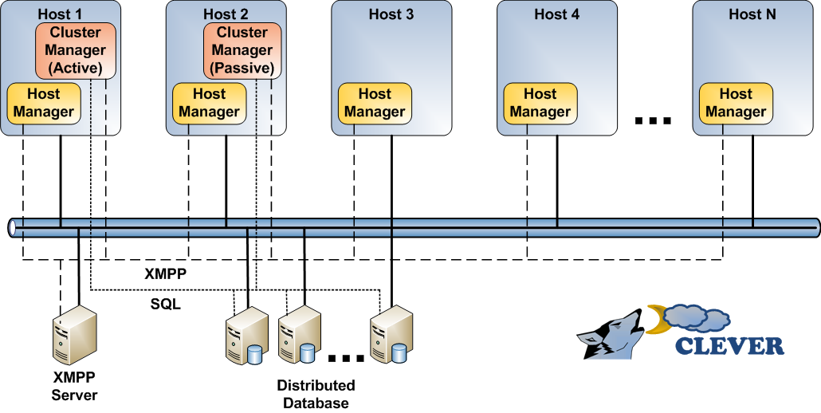
Architettura di CLEVER

Slide 5
Cloud Manager
Cloud
remota
Cloud

Slide 6
Science gateway
Collaborazione con il gruppo di Roberto Barbera
L’architettura dei SG è aperta per gestire dai singoli computer al cloud passando dai cluster e le grid
Il nostro lavoro sulla federazione si adatta bene ai requirements per estendere SG alla cloud

Slide 7
Catania Science Gateway Framework architecture
Embedded Services
Administrator
Scientist
Cloud tenant
.......
App. 1
App. 2
MyCloud
Catania Science Gateway
Use case #1
Use case #2
Grid/Cloud Engine (based on SAGA)
CLEVER Orchestrator (based on OCCI)
Cloud #1
Users belonging
to Identity Federations
HPC
Clusters
Cloud #2
Cloud #n
Single logical domain

Slide 8
The Catania Grid & Cloud Engine
Liferay Portlets
Grid/Cloud
Engine
Science
GW 1
Science
GW 2
Science
GW 3
eToken
Server
Science GW Interface
Data Engine
Job Engine
Users Track &
Monit.
Users
Tracking
DB
SAGA/JSAGA API
Grid/Cloud/Local MWs
Updated
New
New
Updated
Updated
New

Slide 9
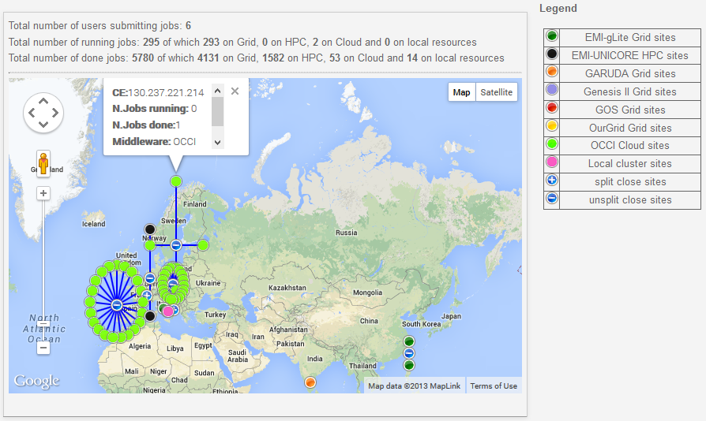
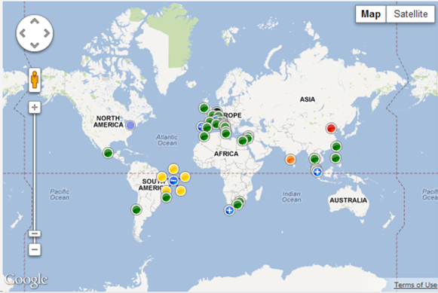
Running applications on various types of e-Infrastructures

Slide 10
Use case: JSAGA Adaptor for OCCI
Science Gateway
Catania Grid/Cloud Engine
Security context
Job management
Stage-in/out
Adaptor
SG
VM
robot certificate
start VM
SG
VM
1) stage-out
VM
SG
stage-in
& run app
2) kill VM

Slide 11
Use case: federation
Cloud 1
M/W 1’
Cloud n
M/W n’
Cloud 2
M/W 2’
Cloud 7
M/W 7’
Cloud 3
M/W 3’
Cloud 6
M/W 6’
Cloud 4
M/W 4’
Cloud 5
M/W 5’

Slide 12
Use case: federation
Cloud 1
M/W 1’
Cloud n
M/W n’
Cloud 2
M/W 2’
Cloud 7
M/W 7’
MyCloud
Cloud 3
M/W 3’
Cloud 6
M/W 6’
Cloud 4
M/W 4’
Cloud 5
M/W 5’

Slide 13
Actual testbed configuration
8 clouds
6 countries
3 m/w stacks
1 SME
GR
IT
IT
CZ
Cloud
ES
ZA
FedCloud
EG
ES

Slide 14
MyCloud Architecture: current implementation
Cloud m/w X
Cloud m/w Y
Local
Storage
Local
Storage
OCCI
OCCI
sync
OCCI
OCCI
orchestrator
sync
CLEVER orchestrates
Computing
Stateless VM handling
MyCloud
CLEVER Client API
Local
Storage

Slide 15
MyCloud Architecture: next step
Cloud M/W X
CDMI
Object
Storage
CDMI
Cloud M/W Y
OCCI
OCCI
CDMI
OCCI
OCCI
orchestrator
CLEVER orchestrates
Storage
inter cloud migration
image management
Network
DNSmasq / OpenVSwitch
Computing
Stateful VM handling
MyCloud
CLEVER Client API

Slide 16
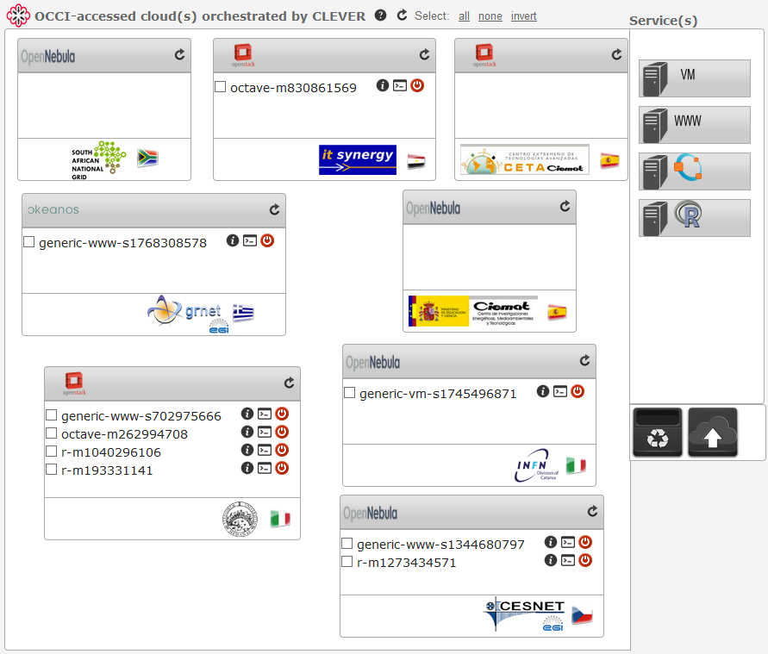
MyCloud @ the CHAIN-REDS Science Gateway
Current functionalities:
Federated authentication
Fine-grained authorisation
Single/multi-deployment of VMs on a cloud and across clouds
Single/multi-move of VMs across clouds
Single/multi-deletion of VMs on a cloud and across clouds
SSH connection to VMs
Direct web access to VMs hosting web services

Slide 17
MyCloud & European Projects
agINFRA (www.aginfra.eu) agricultural data repository and semantic web
CHAIN-REDS
eI4Africa (www.ei4africa.eu) eInfrastructures for Africa
DCH-RP (www.dch-rp.eu) digital preservation for cultural heritage
And some other national activities
2 cloud sites in Catania are under approval by EGI Federated Cloud

